Slide 1
Kabam Collider Proposal
Team
The Visible Hand
Members
Zarek Brot-Goldberg, Ph.D. student in Economics
Jordan Ou, Ph.D. candidate in Economics

Slide 2
Agenda and Overview
How do we deal with Apple’s strict pricing tiers?
Implement region-specific sales strategies instead
How do we establish the optimal “price”?
Finding the optimal sales strategy requires knowing only the demand curve
How do we estimate demand?
Run an experiment (A/B testing) for each region, varying the sales strategy for each treatment group
Final implementation and extensions

Slide 3
Setting Regional “Prices”
We want to vary prices for buying in-game currency across regions, but because of Apple’s restrictions, adjusting exchange rate not possible
Instead, we consider thinking about discounts on the prices of in-game items (in terms of in-game currency)
This changes the value of purchasing units with real currency
Effectively similar (potentially better even) to adjusting exchange rate

Slide 4
Typical Consumer Path
Dollars
Units
Items

Slide 5
Typical Consumer Path
Dollars
Units
Items
Can’t change this!
So we’ll change this instead!

Slide 6
Establishing the optimal price
Objective: Price p maximizes revenue
Assuming zero marginal costs of providing virtual good
Revenue R(p) = p x D(p)
D(p) is quantity demanded for the virtual good at price p
Main information we need is just demand each region
What is the best and most accurate method of estimating demand?

Slide 7
How should we estimate demand?
Demand curve describes the relationship between price and the quantity consumers want to buy
So many confounding variables can affect the price/quantity relationship, resulting in biased or noisy demand estimates
Ideal data for estimating demand: Different (p,q) points in the exact same environment
Same region, time and market conditions

Slide 8
Concerns About current data and methods
Suppose we want to set prices of Marvel in China. Current data is some combination of:
Same product in a different region (Marvel in the U.S.)
Different product in the same region (Fast and Furious in China)
Industry research
Two main concerns:
Above information often observe one price/quantity per game
Can’t really estimate demand at other prices
Current data relies on advanced econometrics, machine learning
Biased estimates from OLS-based methods (omitted/confounding variables)
Out-of-sample inaccuracy from machine learning (overfitting)

Slide 9
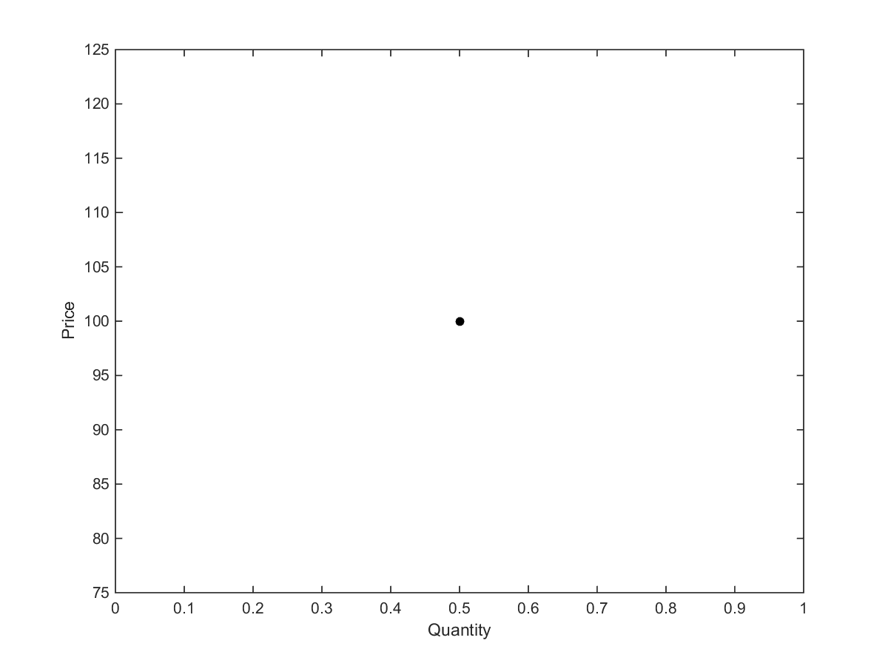
Notes:
Let’s say we know the current quantity demanded at this price…

Slide 10
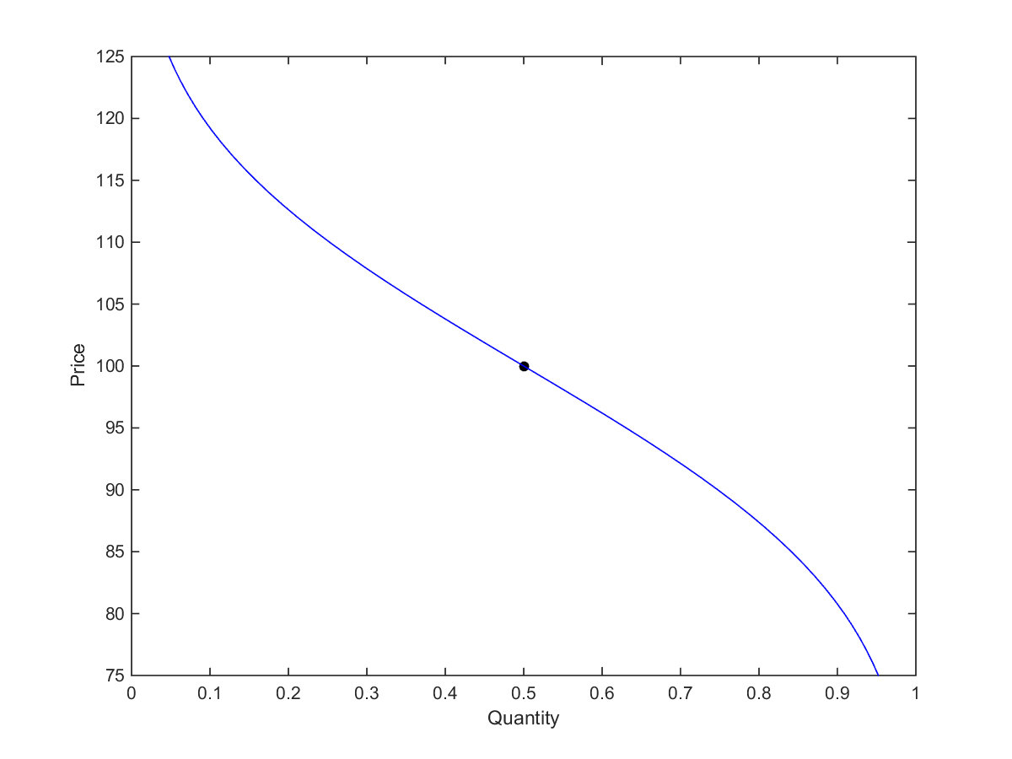
Notes:
Then, the demand curve could be this…

Slide 11
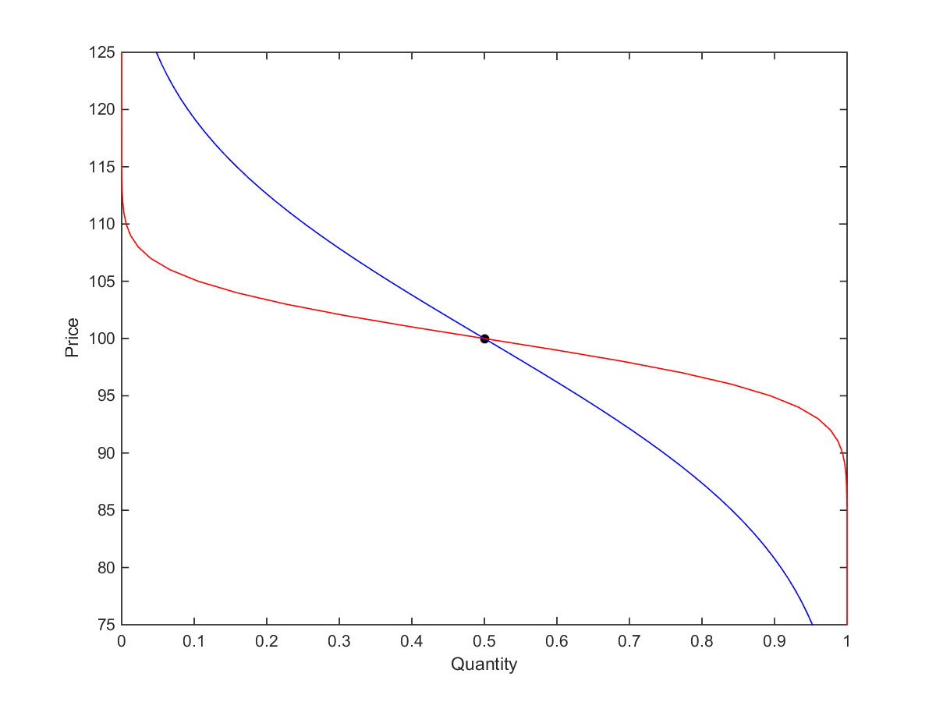
Notes:
But it could also be this? How can we differentiate?

Slide 12
Concerns ABOUT current data and methods
Suppose we want to set prices of Marvel in China. Current data is some combination of:
Same product in a different region (Marvel in the U.S.)
Different product in the same region (Fast and Furious in China)
Industry research
Two main concerns:
Above information often only one price/quantity observation per game
Can’t really estimate demand at other prices
Current data relies on advanced econometrics, machine learning
Biased estimates from OLS-based methods (omitted/confounding variables)
Out-of-sample inaccuracy from machine learning (overfitting)

Slide 13
Proposal for estimating demand
Let’s run an experiment (A/B testing) instead
Assign a subset of players in a region into a control or treatment group
Each group sees a different price for in-game items
Each group provides a data point on price and quantity
Effectively allows for tracing out demand curve for each region
Significant advantages over previously mentioned methods
Confounding variables controlled for in aggregate
Data-driven: very few statistical and model assumptions

Slide 14
Notes:
But it could also be this? How can we differentiate?

Slide 15
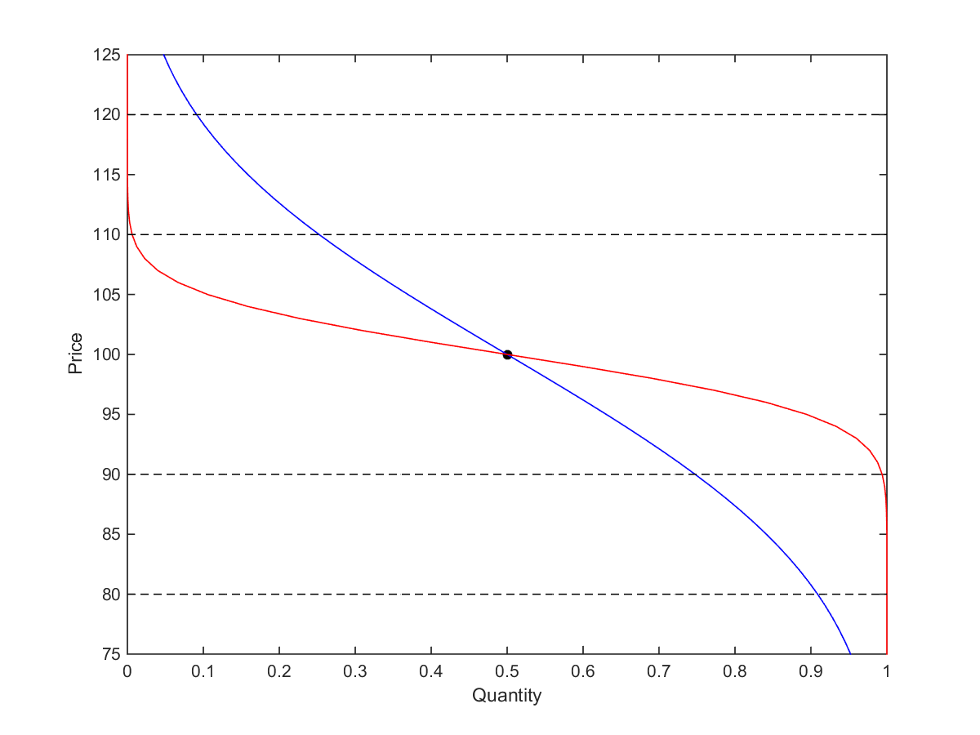
Notes:
Try seeing how much quantity is demanded when we set other prices.

Slide 16
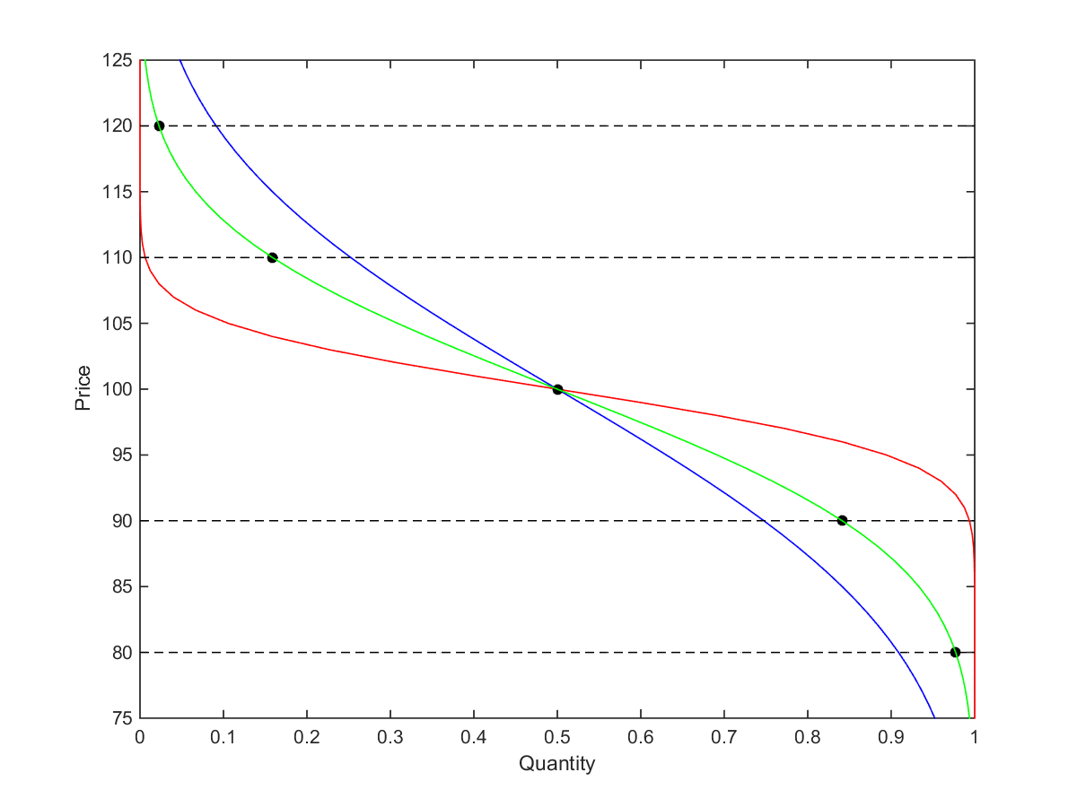
Notes:
This will give us the data

Slide 17
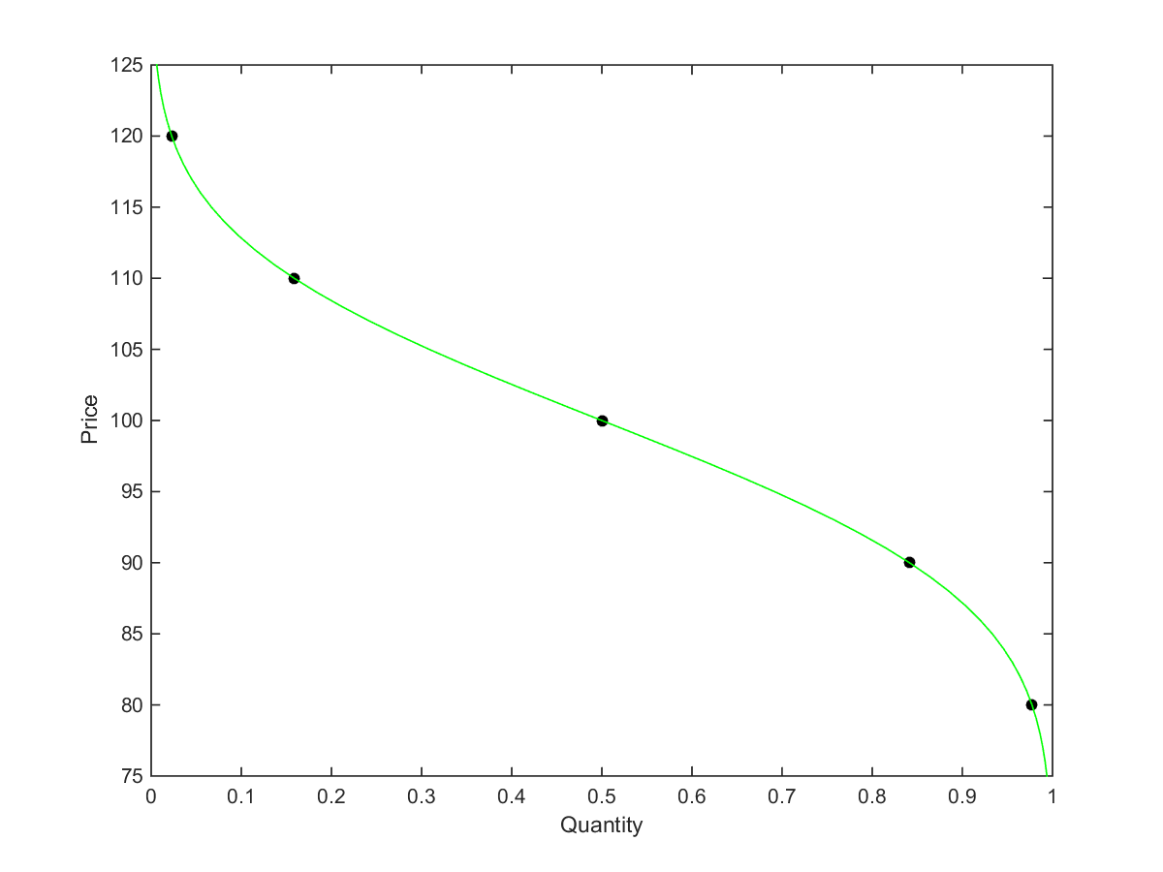

Slide 18
Transforming Results Into Action
After estimating our demand curve, how to translate to ongoing strategy?
Could use different posted prices, but leads to user concerns over fairness and balance
Our proposal to solve this: Rather than set different posted prices for different regions, set up random sales, whose frequency and magnitude varies

Slide 19
How Sales Work
Every day, the game randomly decides whether or not to run a sale, and how large the sale is
Sale applies to region
Sale gives an X% discount for all item purchases that day
Unknown to users, probability of sale varies across regions
How to calculate best sales strategy?
Depends on full shape of demand curve
Can and should integrate other game data
Notes:
3rd bullet point: For example, 1 out of 100 chance of a 5% in the US, 5 out of 100 in China

Slide 20
Why Sales?
Different posted prices lead to user concerns over fairness and balance
Kabam can still capture high revenues from high purchasing power users—they may buy even when there is no sale
Use of sales may pull low purchasing power users into buying and turn them into high purchase users via ‘lock-in’ and investment in game
Easy to brand
Can combine with different posted prices if desired
Notes:
For third bullet point, reference literature on pricing with lock-in

Slide 21
Extensions
With this method, the sky’s the limit when it comes to how to target sales
Implement user-specific promotions and strategies
Incorporate characteristics such as level, frequency of play, past buying behavior
Coupon targeting frequently used by large retailers & advertisers
Highly flexible, can be adjusted easily on the fly without disrupting user experience
Consider using insights on region-specific preferences and demand when designing future games
Example: Adjusting probabilities of receiving different heroes from each crystal (Marvel)

