Slide 1
On Demand Mixed Reality (MR) Solutions for Hardware Support
A Landscape Analysis
ELPP Group 7
April 5, 2022

Slide 2
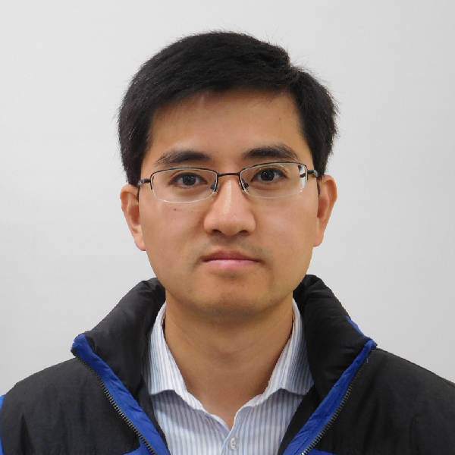
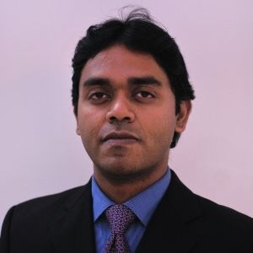
Team
Theresa Guarini
Aniruddha Pal
Bill Yang
Balraj Sadanandan
Santhosh Kumar
Chittiprolu
Xiao Ma
Ping Gu

Slide 3
Product Manufacturing in SEMI Equipment Company
Current Scenario
Businesses
Fab Equipment Sectors
Large Portfolio of Products
Complex H/W Technology
Foundry
$53B
Manufacturing Infrastructure
Large Skilled Workforce
Memory
$52B
Logic
$12B
High Cost of Manufacturing

Slide 4
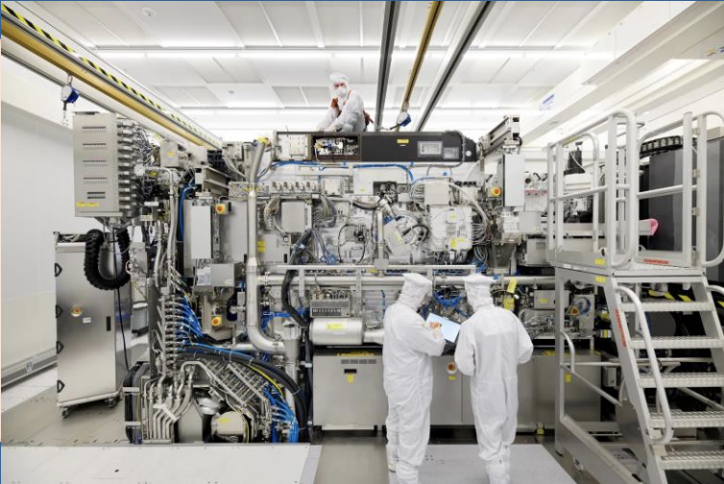
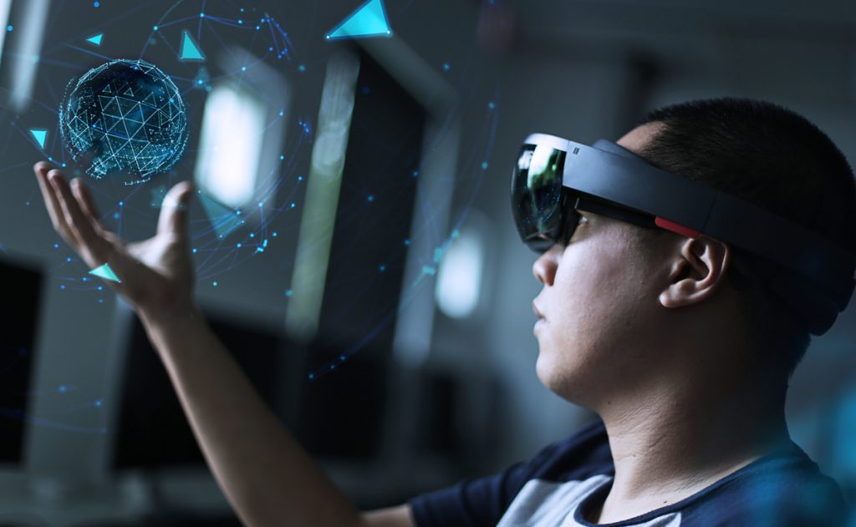
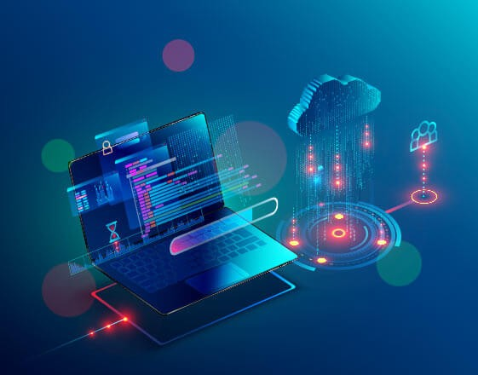
Problem
Non-Standard Manufacturing Processes
Inefficiency in Manufacturing
Longer Training Time
Increased Cycle-time in Manufacturing
New Space
Efficient Manufacturing
Platform with Mixed Reality (MR) Technology
On-Demand
Content

Slide 5
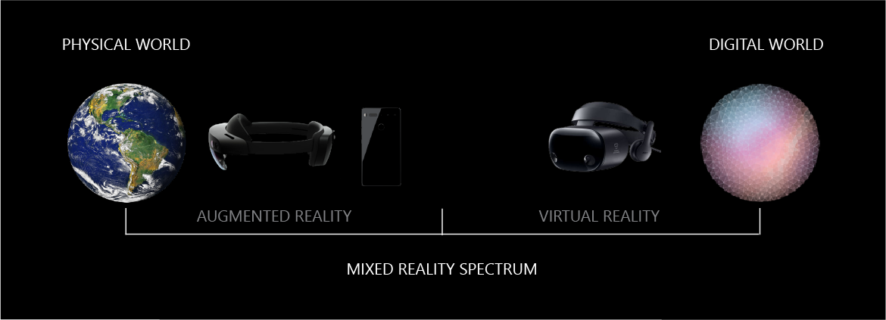
What is XR/MR/AR/VR?
Extended Reality (XR): Umbrella term for VR, AR, MR
Augmented Reality (AR)
Composite of Computer-generated
+ Real World
Virtual Reality (VR)
Fully Immersive Virtual World
Mixed Reality (MR)
Digital Objects/Holograms Interact with User and Real Environment

Slide 6
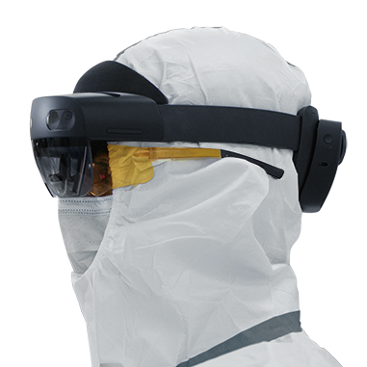
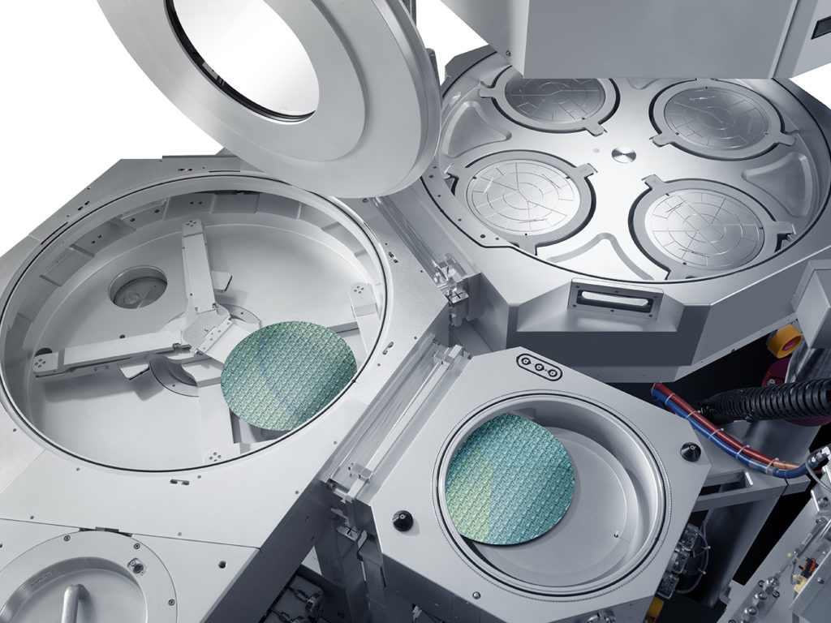
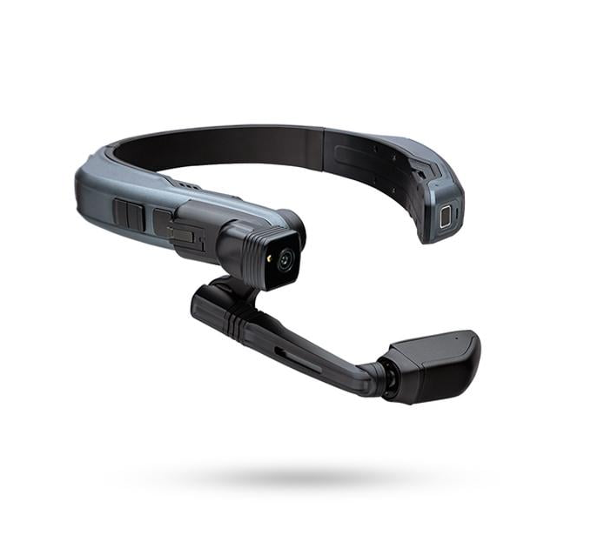
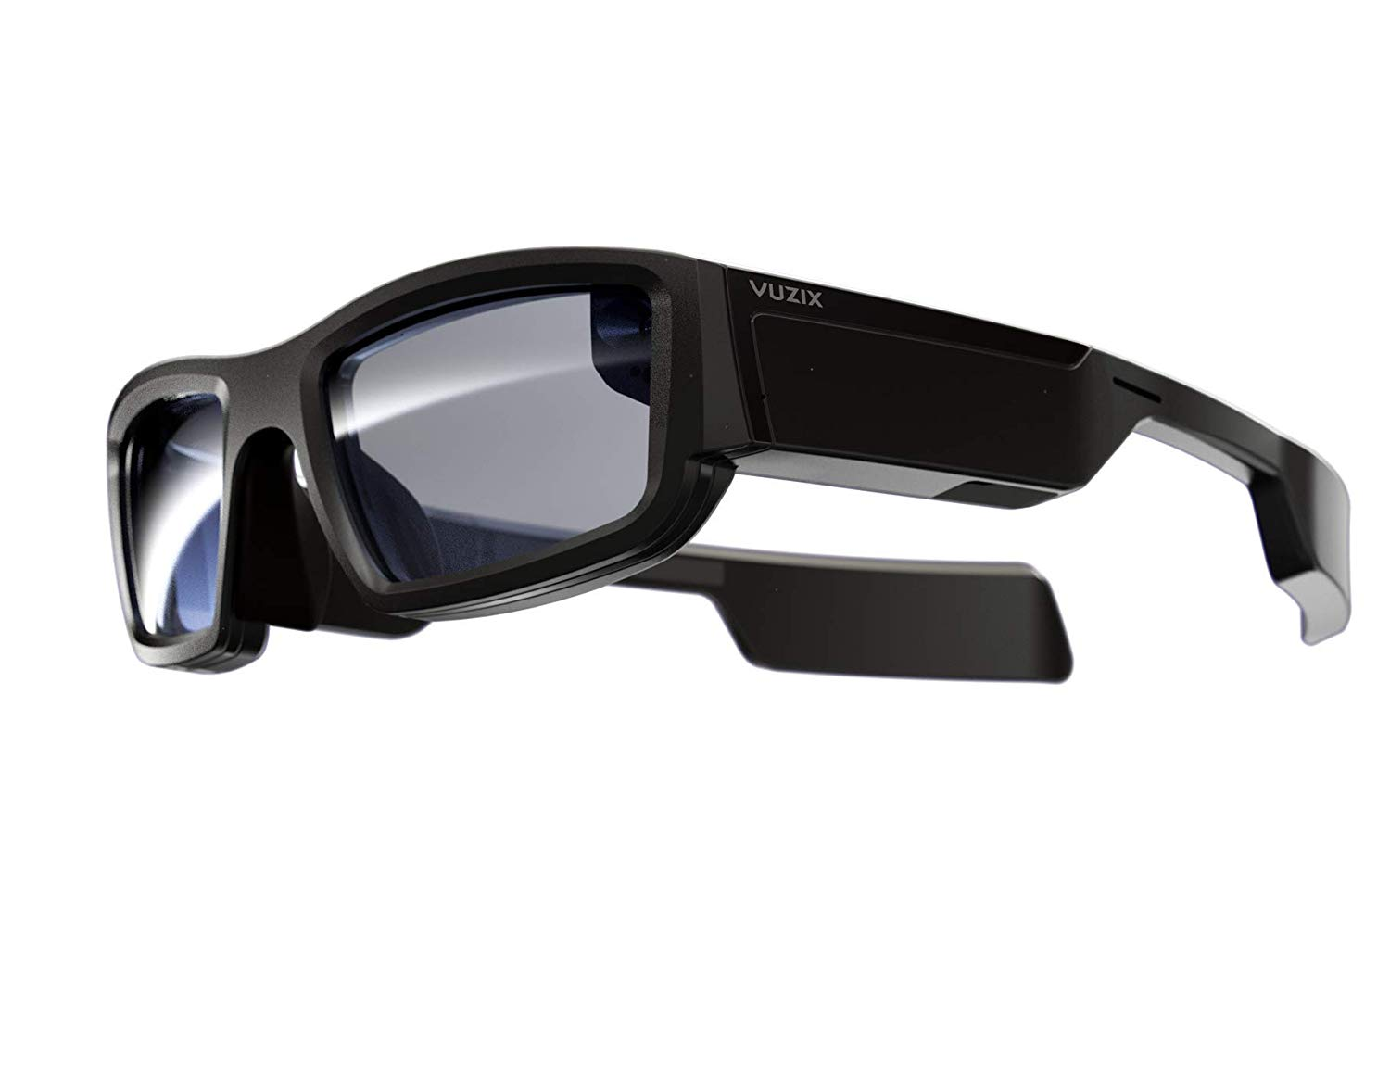
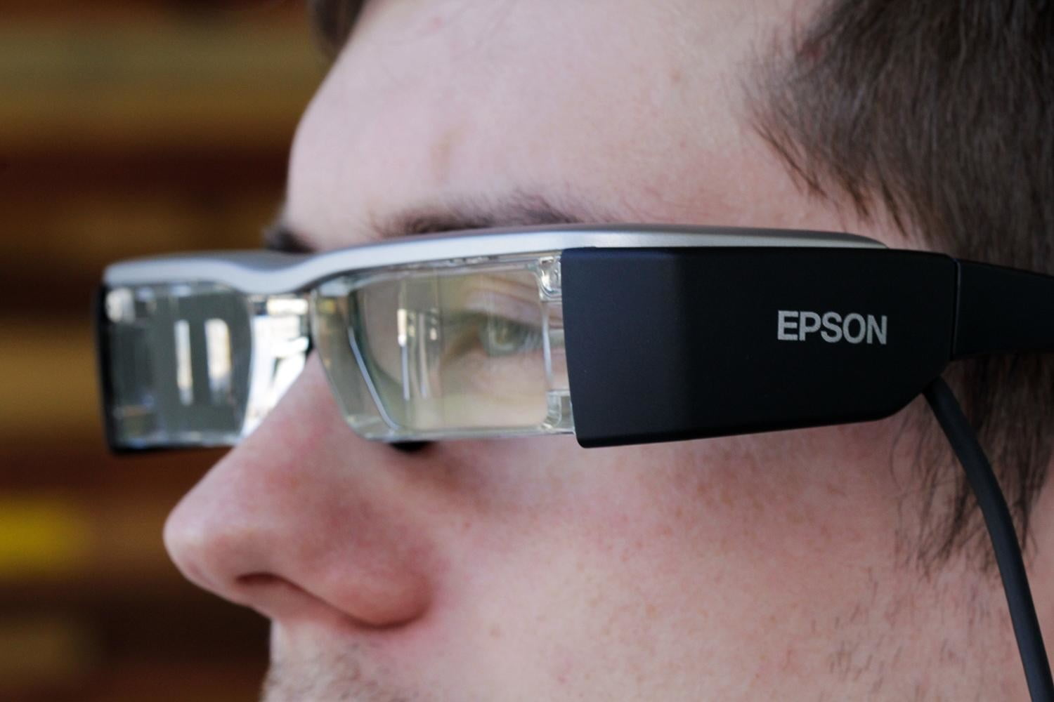
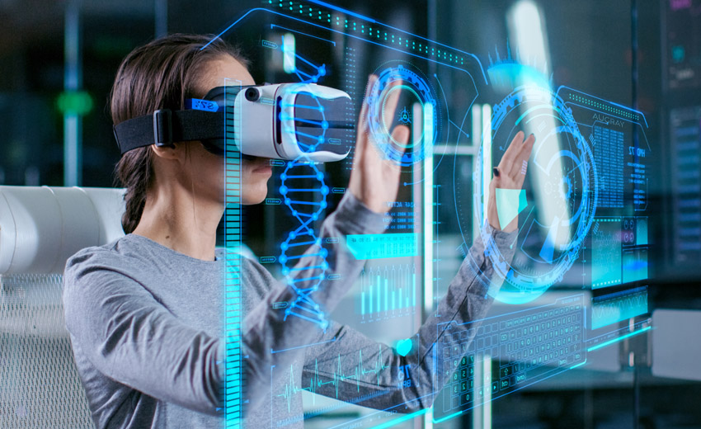
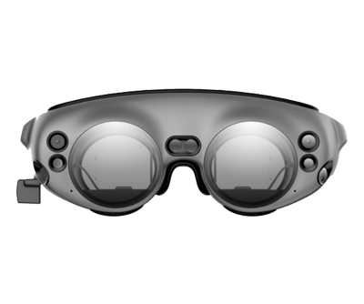
Technology Space
Device / Wearable
Platforms
Content Creation
MR
MR
Open Opportunity
(Client-Oriented)
Microsoft Hololens 2
Customized Content
AR
Realwear
Vuzix
Epson Moverio
Magicleap
AR
Delivery Mechanism

Slide 7
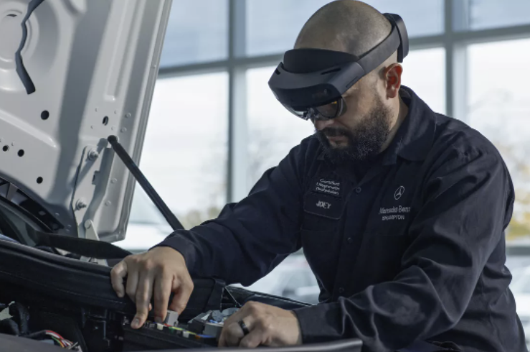
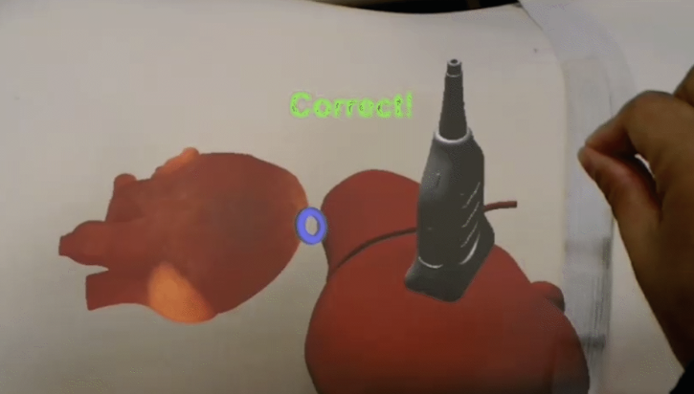
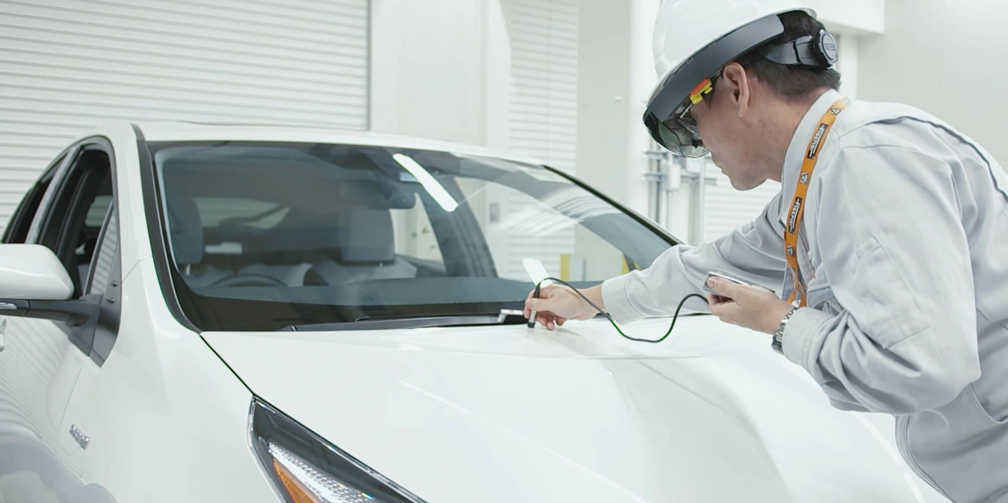
Industry Applications
Automotive
Healthcare
Semiconductor
Equipment
Complex Electromechanical Systems that process wafers for chip manufacturing
1000s of parts and weeks to assemble & test
MR/VR not adopted to accelerate equipment manufacturing
Microsoft Hololens 2 + Dynamics 365
Microsoft Hololens 2
Fast access to wiring-schematics for diagnostics & repair
(Source: techspot.com )
Training ultrasound sonologists –Virtual organs overlaid on top of the mannequin
(Source: ge.com)
Open Opportunity (Client-Oriented)
Customized Content
Delivery Mechanism
Microsoft Hololens 2 + Azure + Dynamics 365
Operators inspect the painted surface
(Source: iot-automotive.news)

Slide 8
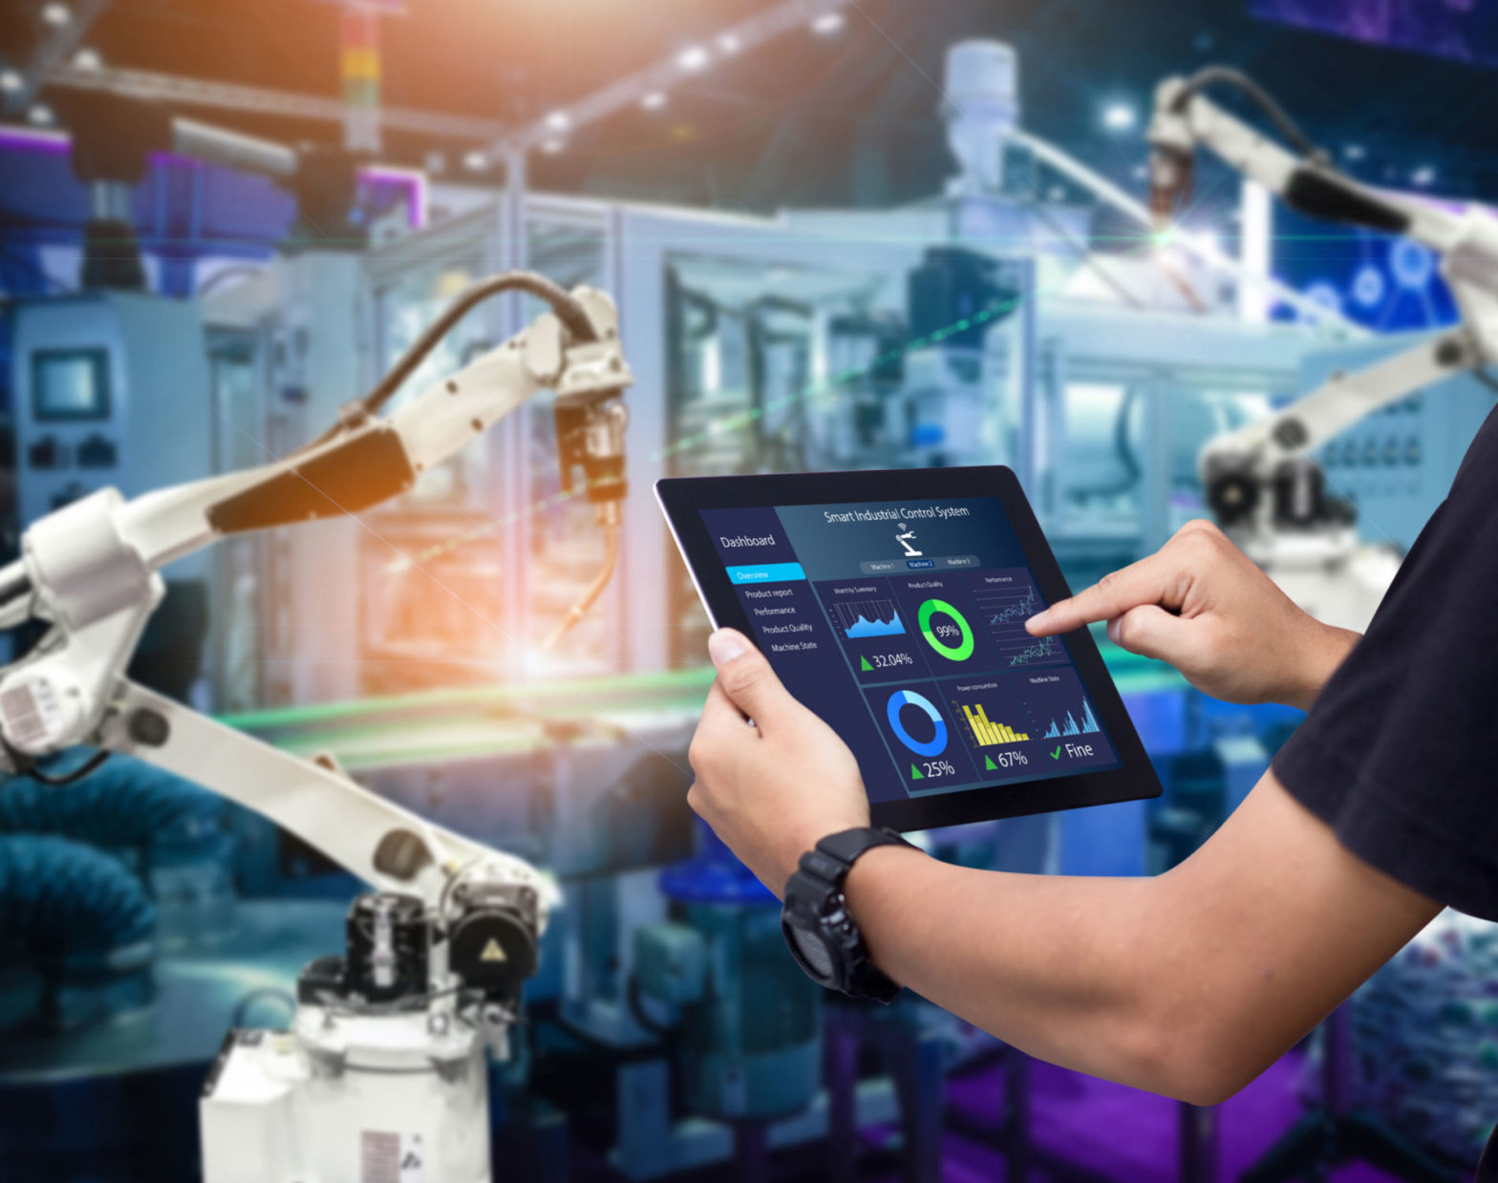
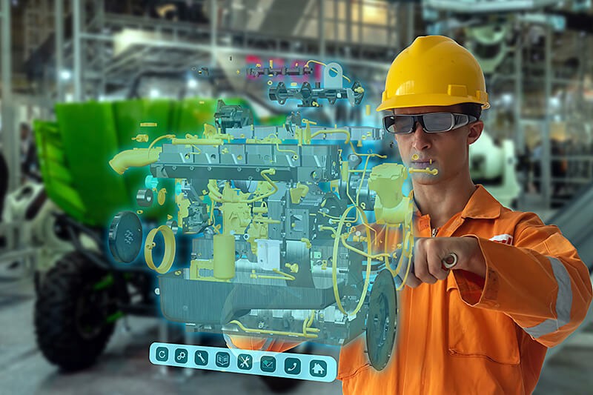
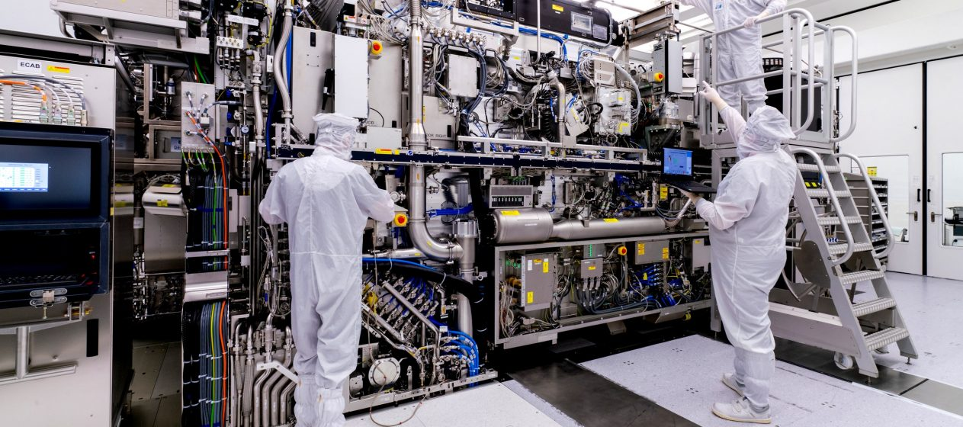
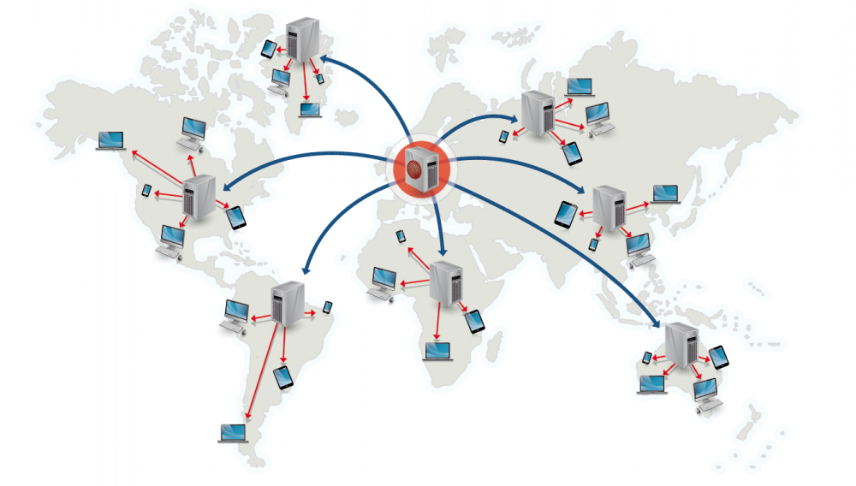
MR Technology Platform in Semiconductor Manufacturing
Customized Content Delivery
MR assisted Manufacturing
Efficiency in Manufacturing of Complex Products
Customized Manufacturing Content
World-Wide Access
Typical Semiconductor Equipment

Slide 9
Opportunity in Semi Equipment Manufacturing
Instant access to customized content
Assembly/Test documentation, 3D models & drawings
20%
faster build-test cycles
Faster equipment rework, troubleshooting & diagnostics
Faster training of personnel
Benefit
Cost
$50 - $200 M/yr
increased revenue per factory
$0.7 - $1.4 M/yr
decreased cost per factory
Cycle time
Factory capacity
Launches / wk
Equipment/Platform License
Highly customized content for building complex HW is key for value proposition
High ROI- very fast payback

Slide 10
Current Status Quo
Why has Semi market not adopted MR
Major Barriers
Benefits of MR Technology not Explored
Scaling scope not defined
Not Budgeted
Challenges in deployment
Long time to Implement System-wide
Notes:
There are no MR adoption in Semi equipment manufactures yet due to the common barriers, as well as unique challenges arising from this specific domain:
Don’t know enough
Don’t have enough expertise to know what it take it to make it successful.
Not sure whether the current SW platform can easily create MR applications for Semi manufacturers
Don't have the budget
This is not part of annual budget and need ROI model to convince executives to invest
Takes too long to implement
Time for implementing may not meet the product development schedule
Don't have enough deployment training
Training may not be enough for being effective and efficient
Unsure about scalability in organization
Even with success of POC, change management in a whole organization is different challenge

Slide 11
Approach to Market
Project Based
Subscription Based
Phase – 1 [Content]
Create Service Contents like:
Customized documentation
Training 3D models
Assembly documentation
Phase - 2 [H/W + Service]
Focus on one kind of wearable device like Microsoft Hololens and Microsoft platform.
Delivery of the Service to semiconductor manufacturing for supporting product experts
Phase – 3 [Platform]
Build up the Platform to provide customized service to semiconductor manufacturing
Concentrated Market Applied Materials, Lam Research, ASML, TEL

Slide 12
Summary
Semiconductor industry will benefit from increased Manufacturing Efficiency
Instant access to build & test documentation, wiring schematics and 3D models, quick data entry
Faster training of personnel
Faster equipment rework & troubleshooting: Creation of recorded sessions & quality tracking
Benefit: Estimated $50 -$200 M/yr increased revenue per factory
Based on 20% reduction in cycle time -> More factory capacity -> More launches / week
Cost: Estimated $0.7 - $1.4 M per factory, Lower Entry Barrier
AR/MR Hardware for equipping all personnel
Yearly license for enterprise/platform
Content <-> HW customization is key for value proposition
High ROI- very fast payback but cycle time savings can be realized only if the content is customized for instant and efficient access

Slide 13
Next Steps
Form Focus Teams
Partner with Semi Manufacturers
Funding and Collaborate with VC's
Experts in Semi manufacture ​
Experts in MR System and App Development ​
​
Concentrated markets
Applied Materials
Lam Research
Understand specific pain points and needs
​
Funding
Network and advices

Slide 14
Thank You

Slide 15
Opportunity in SEMI
Semiconductor industry will benefit from increased Manufacturing Efficiency
Instant access to build & test documentation, wiring schematics and 3D models, quick data entry
Faster training of personnel
Faster equipment rework & troubleshooting: Creation of recorded sessions & quality tracking
Benefit: Estimated $50 -$200 M/yr increased revenue
Based on 20% reduction in cycle time -> More factory capacity -> More launches / week
Cost: Estimated $0.7 - $1.4 M, Lower Entry Barrier
AR/MR Hardware for equipping all personnel
Yearly license for enterprise/platform
Content <-> HW customization is key for value proposition
High ROI- very fast payback but cycle time savings can be realized only if the content is customized for instant and efficient access

Slide 16
ROI Calculation Model
 | NPI factory | HVM factory
Benefit
Launches/week | 5 | 20
Increased launches with 20% takt time improvement | 1 | 4
Increase in annual shipments | 52 | 208
Increase in revenue ($ M) | 52 | 208
Cost
Fixed Cost per MR/AR equipment ($K) | 3.5 | 3.5
Fixed Cost for equipment for all personnel ($K) | 350 | 700
Enterprise yearly per-license cost ($K) | 3.5 | 3.5
Total yearly license cost ($K) | 350 | 700
Total yearly cost ($ M) | 0.7 | 1.4

