Slide 1

Landscape - Enterprise collaboration in Metaverse
Team 4
Elpp 2022 SPRING
Uc bERKELEY, COLLEGE OF ENGINEERING

Slide 2
What is Enterprise Collaboration
Video/collaborative Meetings
Unified Messaging
Social networks
File sharing
Intranet platforms
Project management and analytics
Business process management
Traditional Players
  Adobe
  Bluejeans
  Cisco
  Facebook
  IBM
  Igloo
  VMware
  Microsoft
  Atlassian
  Google
  Slack
  Zoom
  Polycom
Traditional Players
  Adobe
  Bluejeans
  Cisco
  Facebook
  IBM
  Igloo
  VMware
  Microsoft
  Atlassian
  Google
  Slack
  Zoom
  Polycom
Overall Global enterprise collaboration market size is expected to grow from $36.24B in 2020 to $82B by 2028 at a CAGR of over 10.7%*
Collaborative Meetings
* Mordor Intelligence Ent. Collaboration market report, 2022

Slide 3





Current State…
In person meetings are interactive
and immersive
Boring square grid meetings
We deserve better

Slide 4

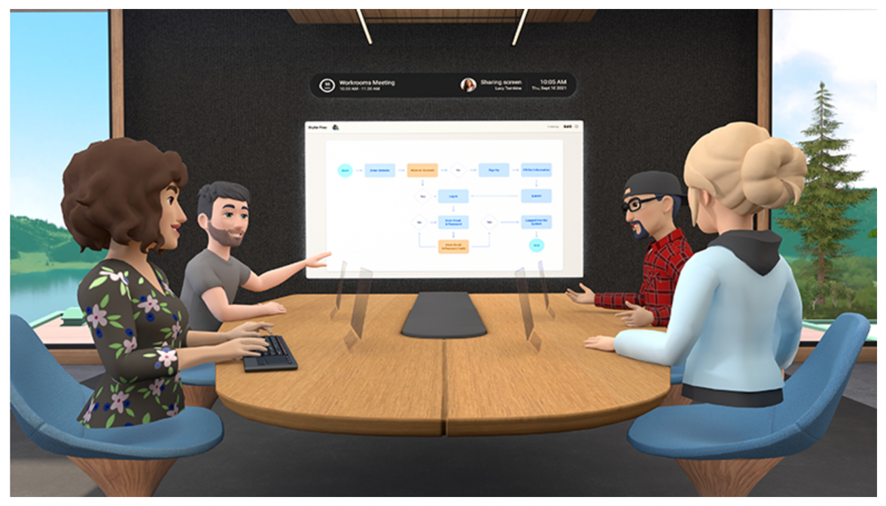
Metaverse the next frontier
“We’ll be able to feel present, like we’re right there with people, no matter how far apart we actually are,” - Zuckerberg
No geographical barriers
Lifelike Avatars
Immersive experience
Higher productivity

Slide 5
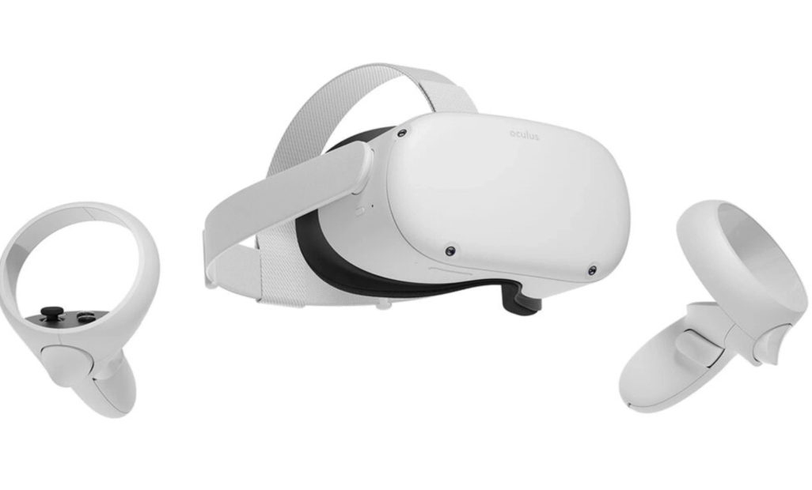
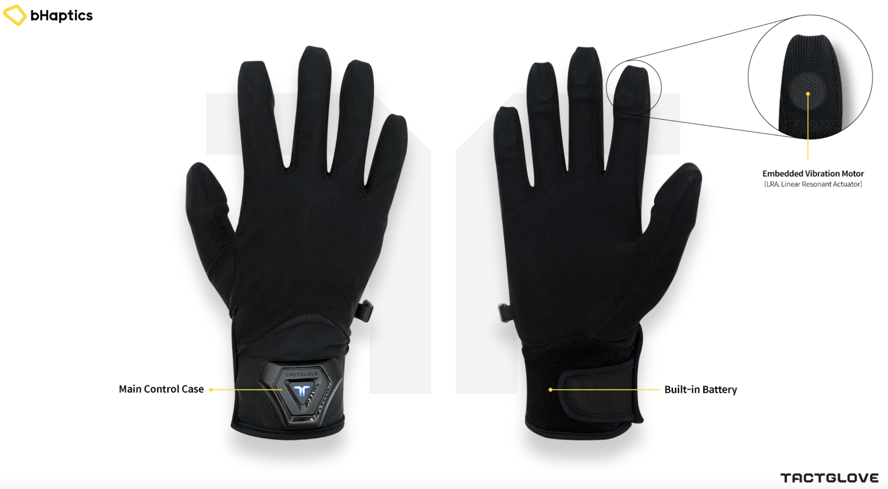

Metaverse collaboration from Meta (Facebook)
Horizon meeting rooms
Current investment pipeline: $10 Billion

Slide 6
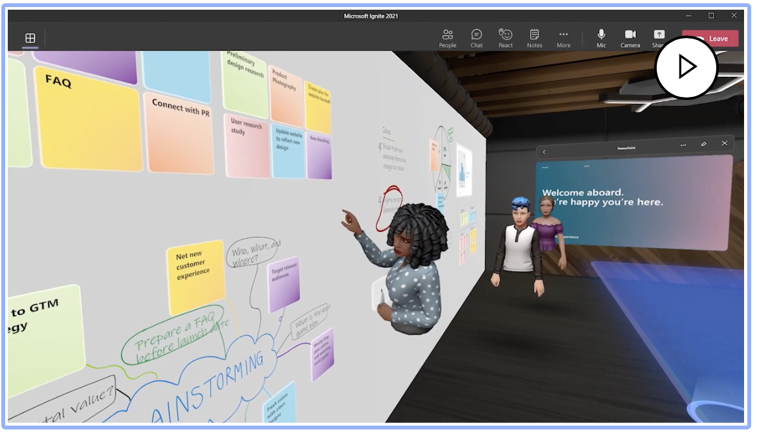
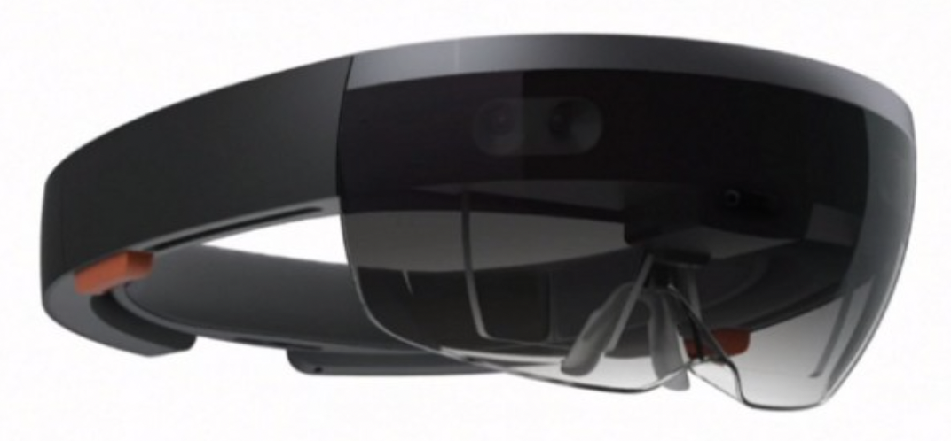
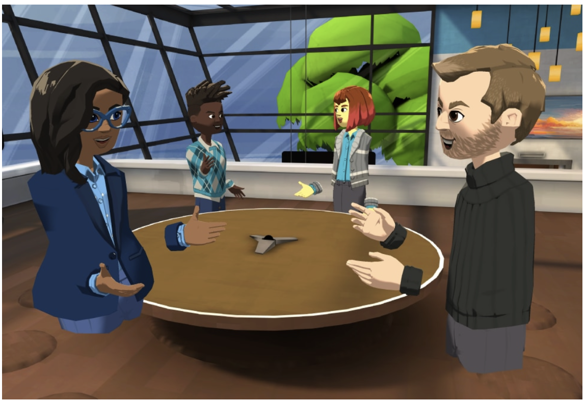
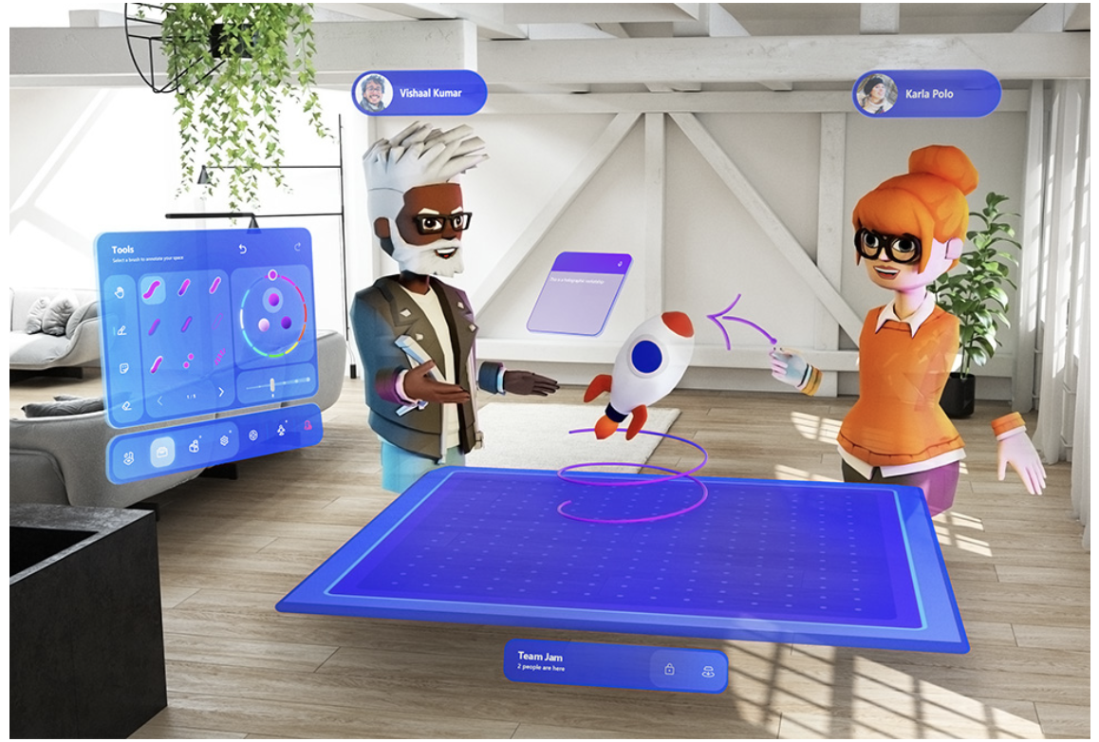

Metaverse collaboration from Microsoft
Mesh
Current investment pipeline: $ 60 Billion

Slide 7
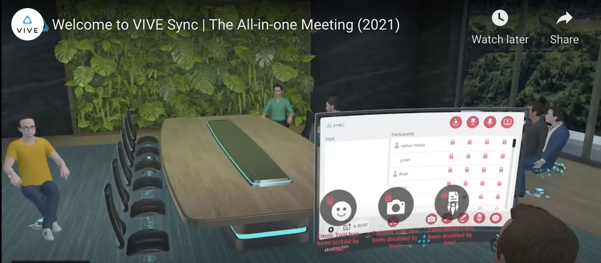


Metaverse collaboration from HTC
HTC Vive Sync

Slide 8
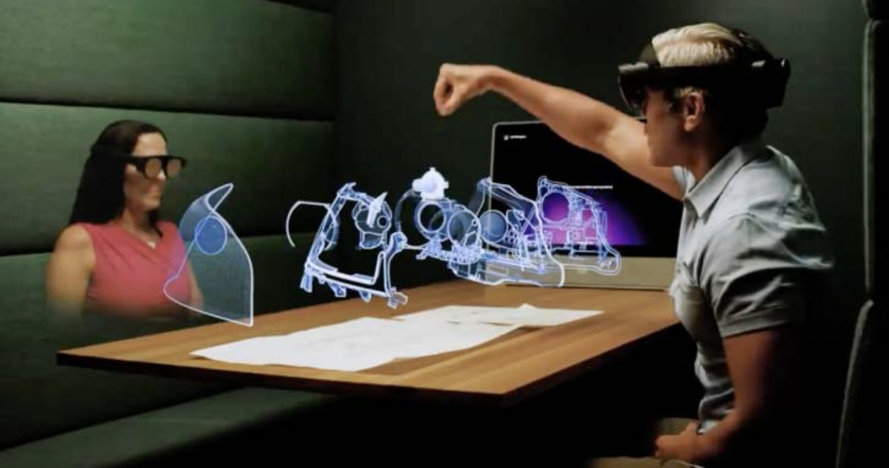
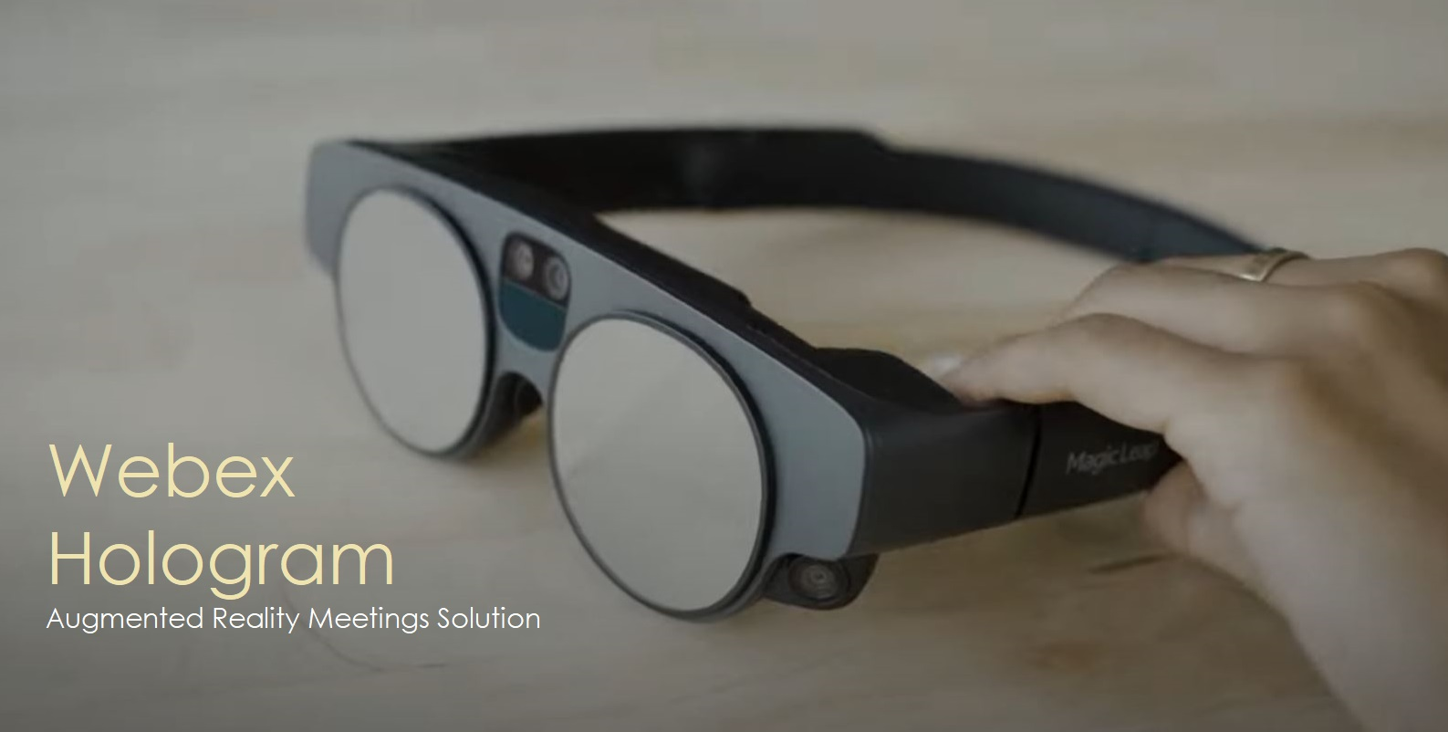

Metaverse collaboration from Cisco
Cisco Hologram

Slide 9
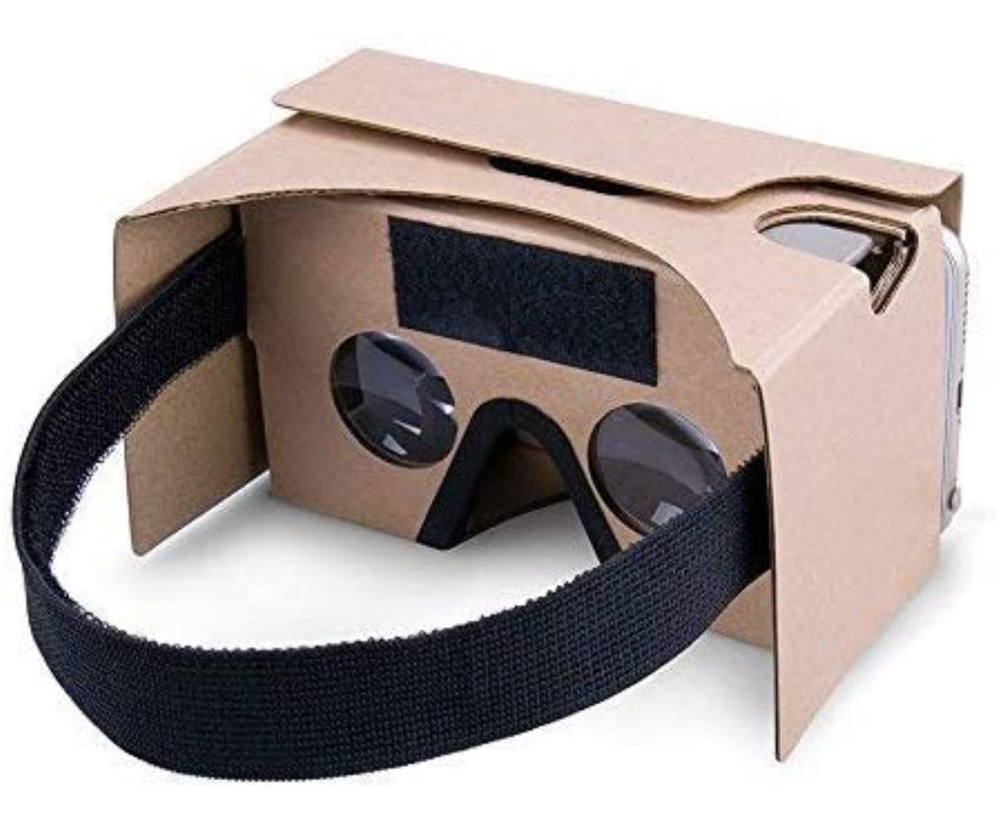
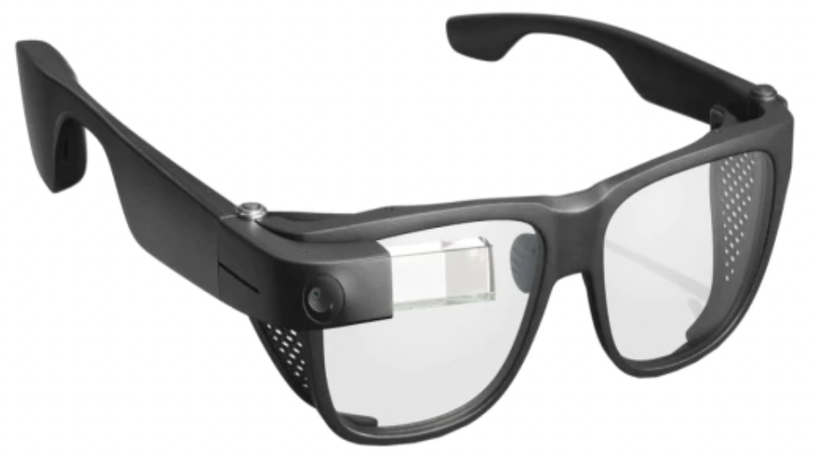

Google’s failed attempts
Transitioned to Software player.
Current investment pipeline: 33.5 million in a private equity fund

Slide 10

Market Size
2028 Forecast
Enterprise Collaboration* – 82b
Metaverse Collaboration Prediction
~40b
* Grant View Research report on Ent Video market, 2020
** Mordor Intelligence Ent. Collaboration market report, 2022
Enterprise Video Market** - 38b

Slide 11
Are enterprises ready
2028 Forecast
Enterprise Collaboration – 82b

Slide 12

Four pillars to success
Adoption
Apps
Collaboration in Metaverse
Eco System
Security
Notes:
Echo System: Best in class human interfacing devices, High speed network

Slide 13
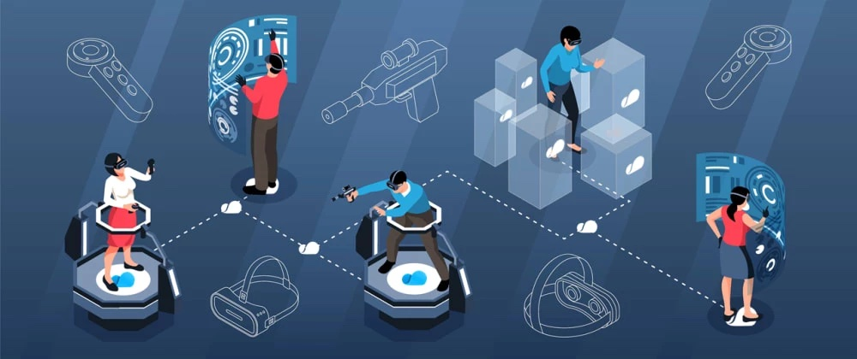
Adoption
Age – Attract mature enterprise customers.
Access – Make it ubiquitous
Cost – Cheaper for SMBs and Educational institutions to adopt
Simplicity - Easy to use
Adoption
Apps
Collaboration in Metaverse
Eco System
Security
Notes:
Adoption: Easy to use human interfaces, Trust, Behavior modification

Slide 14
Apps
Unified messaging
Project Management applications
Non-metaverse application integration
Realistic professional avatars
Adoption
Apps
Collaboration in Metaverse
Eco System
Security
Notes:
Apps: Simulating reality, Lifelike avatars, Converge physical and virtual space, Efficient data sharing, Crypto Assets

Slide 15
Eco System
Hardware – CPU, GPU, Storage
Network bandwidth
Superior optical technologies
Environmental Impact reduction
Adoption
Apps
Collaboration in Metaverse
Eco System
Security
Notes:
Echo System: Best in class human interfacing devices, High speed network

Slide 16
Security
Enforce Privacy
Provide User, data and network security
Protect users from abuse, racism, harassment
Web 3.0 and blockchain integration
Adoption
Apps
Collaboration in Metaverse
Eco System
Security
Notes:
Security: Uncompromisable identity, authenticity and privacy

Slide 17

Tale of two markets
Metaverse is a Trillion-dollar opportunity
Incumbent
Players
Microsoft
Google
Cisco
Zoom
BlueJeans
Mature VR/AR solutions for enterprise collaboration
Enterprise Collaboration in Metaverse - $40B opportunity
Niche
Players
Mature Metaverse concepts and make / reinvent collaboration as part of the overall virtual world
Microsoft (mature VR applications)
Meta (Facebook)
HTC

Slide 18
Technical challenges
Interoperability between different Metaverses
Danger of omnipresent cyber attacks for enterprises
Needs lot of resources which are real and limited

Slide 19
Market challenges
Appetite for remote collaboration declines – return of in-person collaboration.
Governance, Legal and Fiduciary compliancy requirements inhibit adoption.

Slide 20
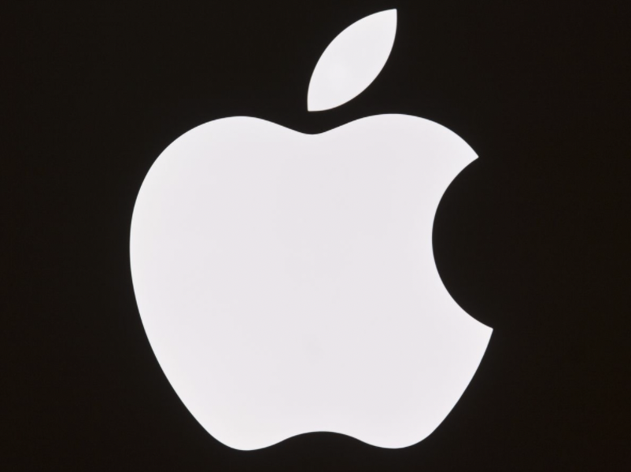
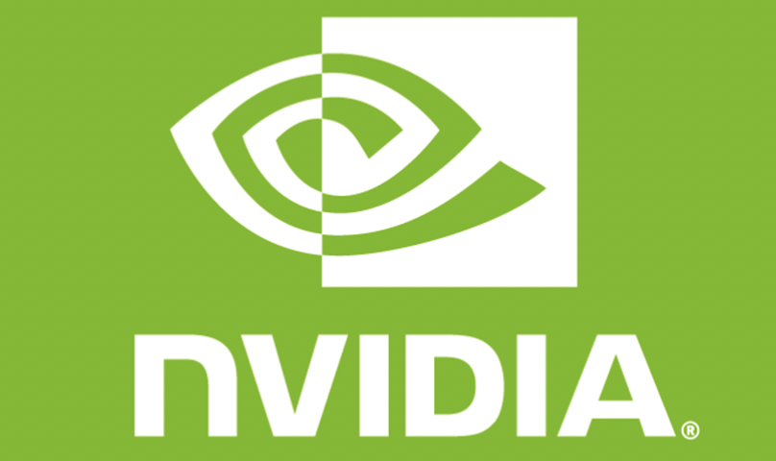


Key Takeaways
Hybrid work is here to stay.
Metaverse offers great potential for enterprise collaboration, engineering and design.
Collaboration solutions that focus on adoption, applications, ecosystem and security will lead the market.
Billions of dollars being invested by Microsoft, Meta platforms, Google, Sony, Apple, nVidia, Qualcomm

Slide 21

Q & A
Team 4
SUBRA MANUGURI, MANU JOSE, RAMAN PEKETI, MIKE GEMANIS, ADITI RANE, BHAUMIK SHERDIWALA, Gaurav batra

