Slide 1
Group 3
OSAA Collider Project

Slide 2



Group 3
Jimmy Huang
Erwin Sutiono
Shuen Hwee Yee
Sean Xiao
Engineering Project Management
M.S. Mechanical Engineering ’17
University of California, Berkeley
Product Design
M.S. Mechanical Engineering ’17
University of California, Berkeley
Product Design
B.S. Mechanical Engineering ’16
University of California, Berkeley
Manufacturing
B.S. Mechanical Engineering ’17
University of California, Berkeley

Slide 3
Agenda
Market Analysis
Design Considerations
Current Prototype

Slide 4

Value Propositions
Increases Patient Mobility and Quality of Life
Affordable and Cost Effective
No Switching Inertia for Users

Slide 5

Target Customers and Users
Customers: Hospitals
Pharmacies
Users: Active Hospital Patients
At-home IV Therapy Patients
Notes:
2 Sided Market

Slide 6
Top Down Market Analysis
136M+ hospital visits/year in the US^{[1]}
90% will receive infusion therapy one way or another^{[2]} = 122M yearly users
$25 average cost of receiving infusion therapy in the US
136M x 90% x $25 = $3B Total Available Market
Notes:
[1] http://www.cdc.gov/nchs/fastats/emergency-department.htm
[2] Jes OSAA Collider Slides
[3]https://www.advisory.com/daily-briefing/2013/08/27/the-secret-of-salines-cost-why-a-1-bag-can-cost-700
http://www.nytimes.com/2013/08/27/health/exploring-salines-secret-costs.html
http://www.nhia.org/faqs.cfm

Slide 7

Design Considerations (Cust)
Overcome Spring Force
RELIABLE
Stop fluid flow
EASY USE
No Air Bubbles
SAFE
Identify quantity of fluid left in bag

Slide 8
Design Considerations (Users)
Comfortable User Experience
Teddy Bear
Arm band
Backpack
Secure Tubing Route
US
Hygiene
Pragmatic Installation
Notes:
Comfortable user experience - users dont look awkward carrying it around; materials used
Pragmatic Installation - no variables in user movement; users able to go to the restroom etc
Secure Tubing route - does not catch on things; doesnt cause dislodge - hematoma
Hygiene - enclosed medication, medicine does not get tampered with

Slide 9
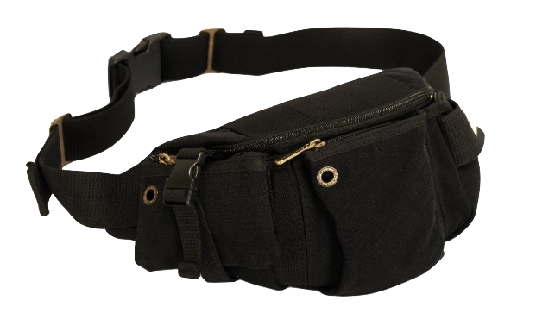
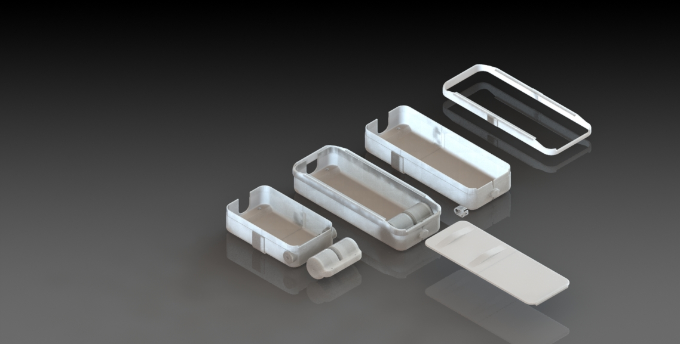
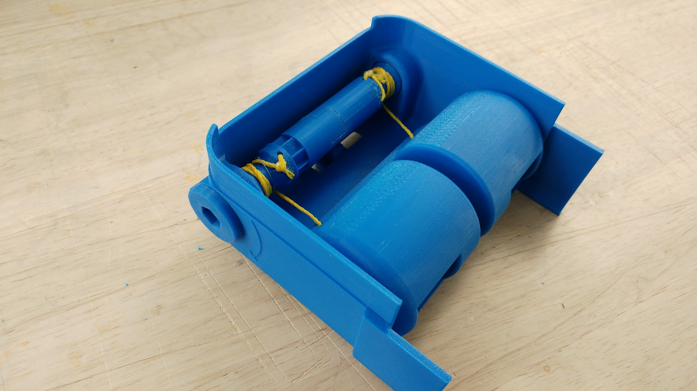
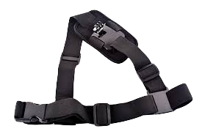
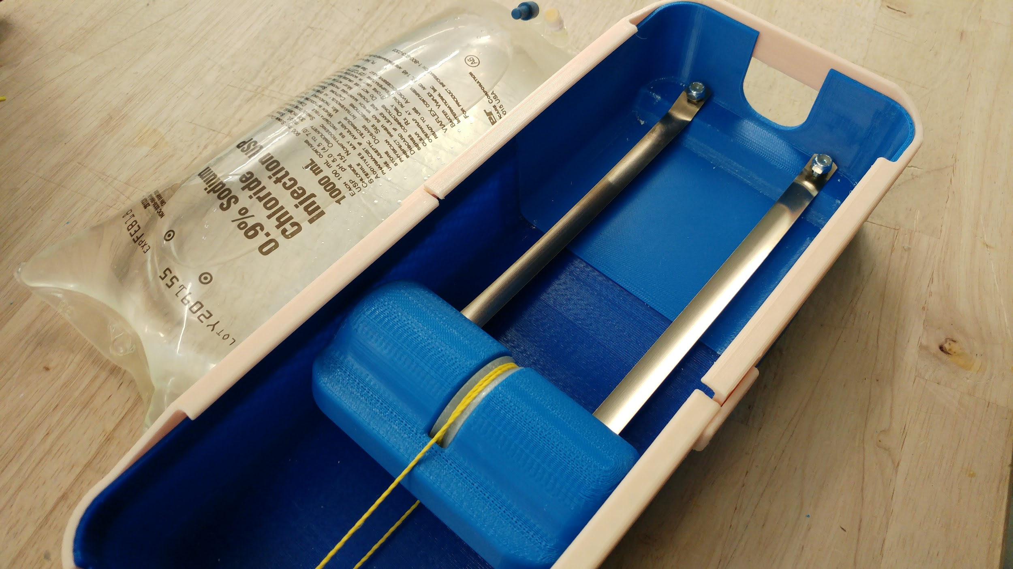
Our Prototype

Slide 10
Pressure Requirement
Central Venous Pressure: <30mm Hg
Conventional IV height above heart: 900mm
Result: ~14lb push

Slide 11
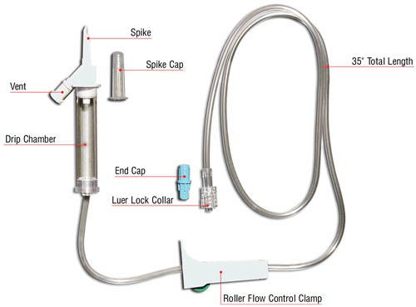
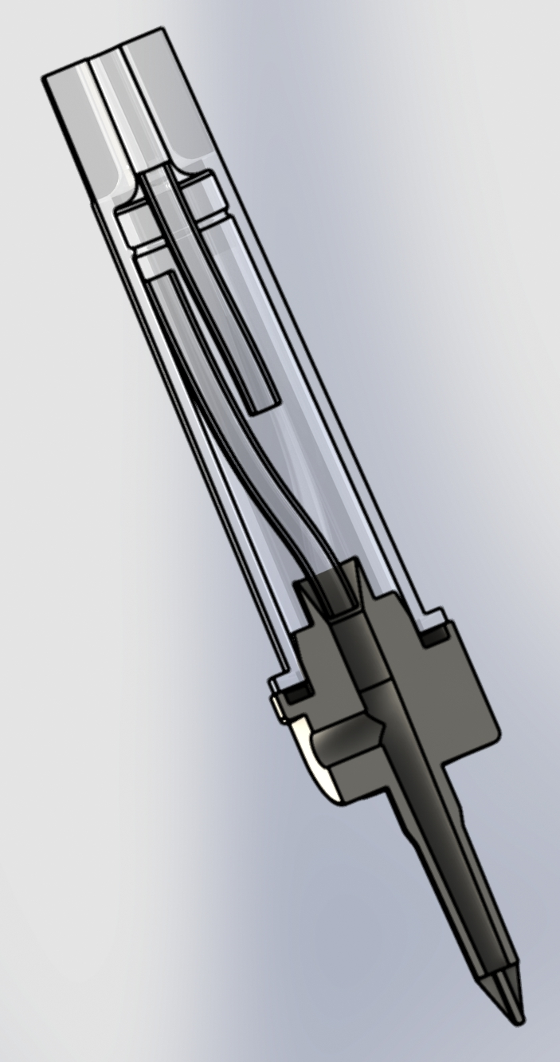
Air Bubble

Slide 12
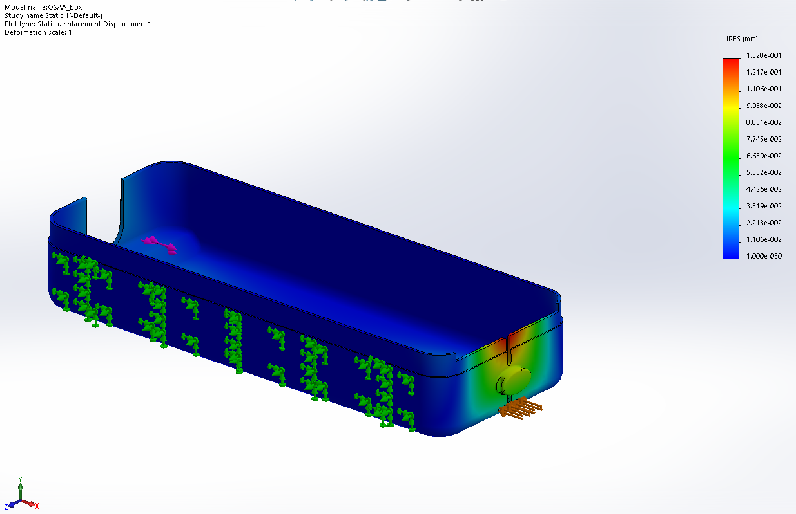
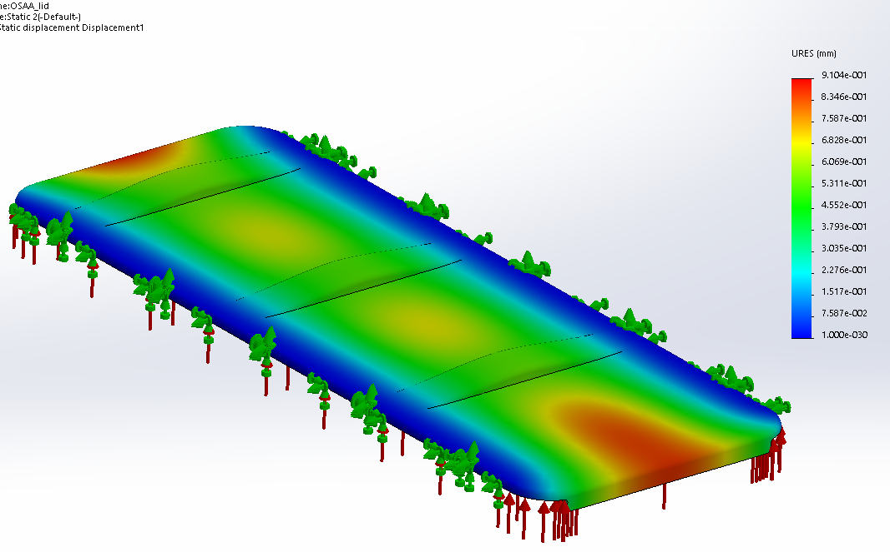
Mechanical Strength

Slide 13
Bill of Materials
Materials | Quantity | Cost/Unit
Constant Force Spring | 2 | $ <9.56 (<500 units)
IV Bag Enclosure | 1 | $ <1.00 (High Volume)
Roller | 1
Nylon String | 1
Total Manufacturing Cost at High Volume: < $ 10.00

