Slide 1
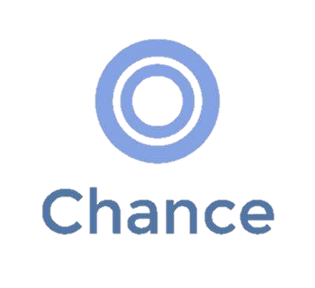
Convenient Financial Access for All
SCET Financial Inclusion Collider Challenge:
Saad Hirani | Wing Vasiksiri | Wyckliffe Aluga

Slide 2
Agenda
The Problem With Financial Inclusion in Pakistan
Our Proposed Solution
Our Product & How It Works
Product Wireframes & Screenshots
Value Proposition
Makeup of Market Opportunity
Market Validation & Research
Revenue & Business Model
Competitive Analysis
Risks, Threats
Timeline
Team, What We Need
Appendices

Slide 3
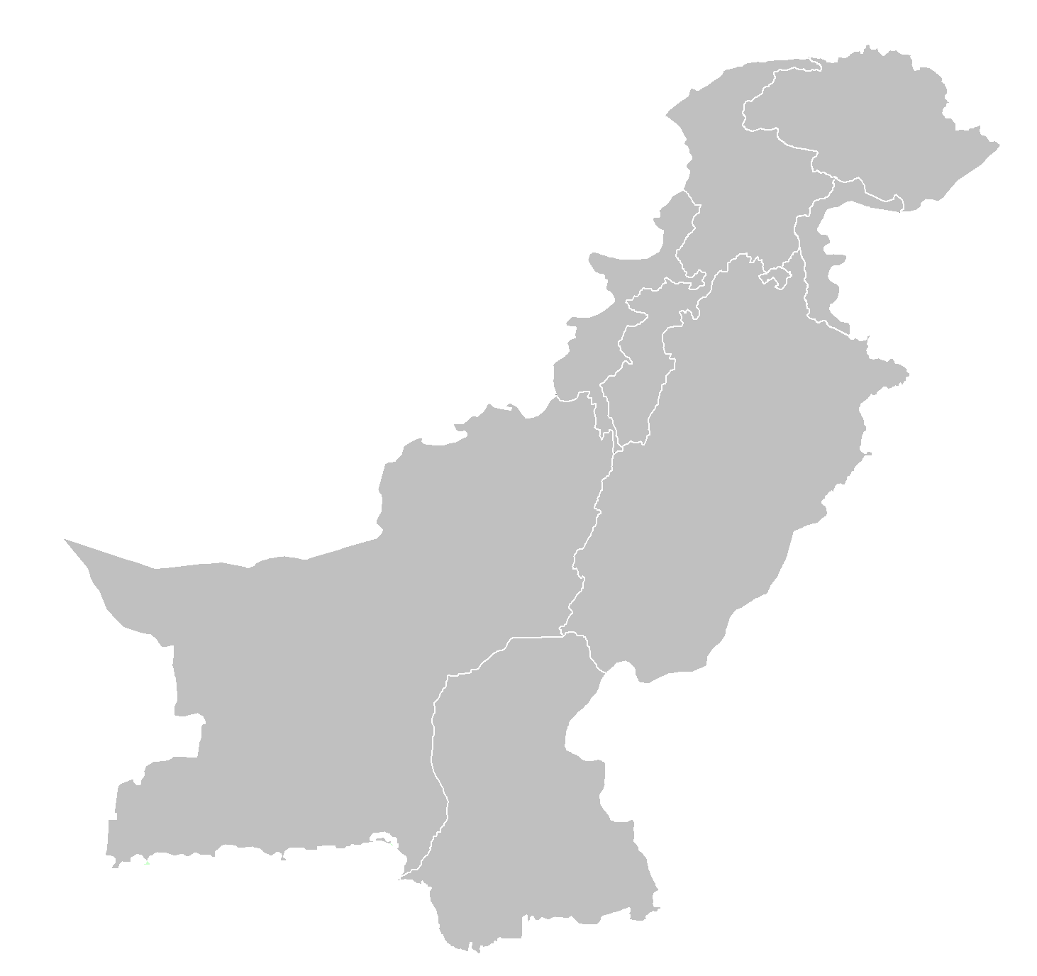
Pakistan’s Inclusion Issue
Adults with Bank Account
Distance to Bank
13%
Lack of Financial Infrastructure
Restrictive Regulations
6%
Governance Failures
Lack of Suitable Products
Adults with Saving Accounts
Notes:
The 6th Largest Population in the world, and arguably the fastest growing lower-middle class suffers from a lack of access to basic financial services and is reliant on the cash economy
13% of Adults (and 4.8% of women) in Pakistan have an Account at a Financial Institution.

Slide 4
Our Solution Concept
Affordable, Bank-less
Financial Services
Focus on increasing use of mobile payment +
Game Changing Hybrid Cost Structure
Notes:
Financial Services at an affordable cost through a medium already possessed by most of the lower-middle income class – cell phones.
Anyone can Send, Receive, Deposit or Withdraw money at the cheapest possible rate, from agents deployed nearby them

Slide 5
Afford the Lower Income
Classes a Chance
Through a Tailored
Adaptable Product

Slide 6

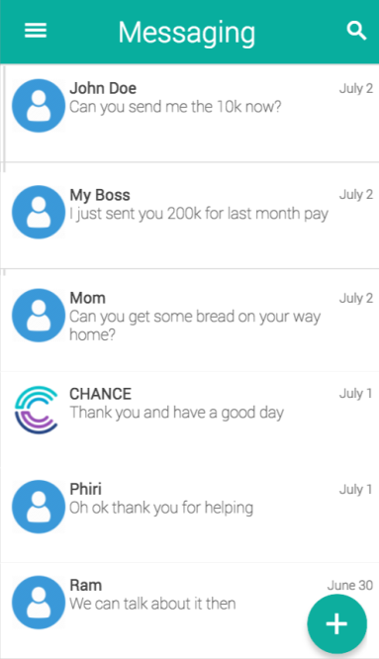
Chance
Open an Account at Significantly Low Cost
Send money to anyone anytime
Deposit Money or Have Money Transferred to You
Withdraw cash anywhere anytime
Save money & Be More Aware of Finances and Liquidity
All that by simply texting

Slide 7
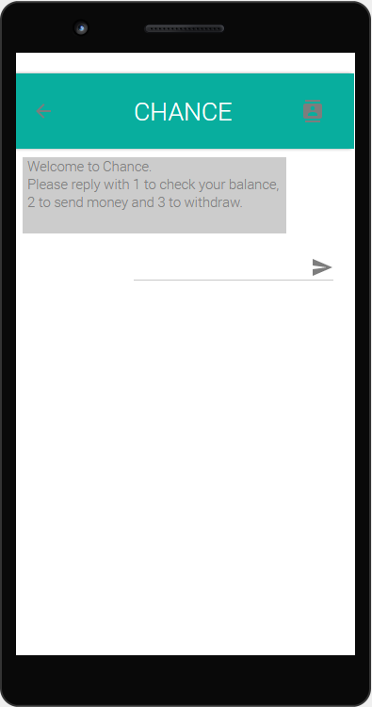
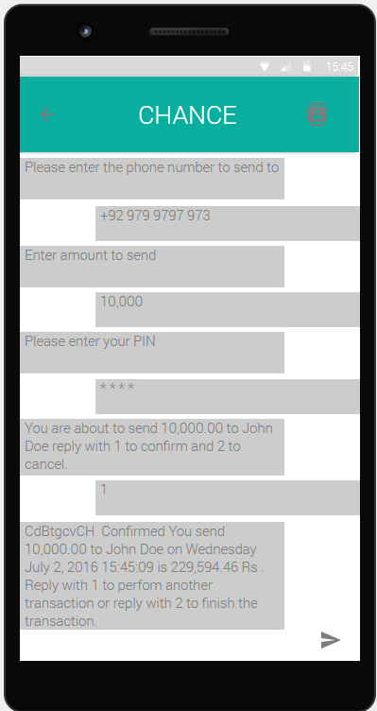
Wire Frames [Sending]
Interface through Text with Multiple Options
SECURITY / IDENTITY VERIFICATION
Transaction Confirmation & Record

Slide 8
Distribution Model
Chance Sales Team
Trains and distributes e-cash to the master agents
Master Agents
Supervise and distribute e-cash to local Retail Agents
Retail Agents
Allow customers to deposit and withdraw cash
Customers
Customers can send and receive the e-cash

Slide 9
Creative Cloud Technology
User mobile phone
SMS Bot API
Load Balancer
Task Manager
Database
Independent, secure technology that is non-dependent on internet connectivity
Notes:
90% of population has mobile phones, SMS bot API purchasable from Microsoft, Load balance program to allow multiple access at quick point (same function withdrawing can’t be used to send etc. at the same point) – boxed part is completely automated and being updated in database at all times

Slide 10
Value Proposition
Safe Storage Mechanism to Increase Savings
Allows Risk Sharing and Expansion of Geographic Networks
Improves Allocation and Deepens P2P Lending / Formalizes Credit Market
Makes it Easier to Pay for, Receive Payments for Goods and Services

Slide 11
Market Make-Up
100m
Total Addressable
Unbanked Population in Pakistan
Market:
$147m
92%
Adult Cell Phone Users
Get paid in cash by factories
2018 Target Market: $1.5m
Income Under $10k / Year
80%
Avg. Revenue / Customer
$2py
Conservative Estimate

Slide 12
Market Validation & Research
Interviewed lower-middle income workers paid daily cash wages in 4 different factories to gauge if they would use product, as well as the viability of product to such customers
Average Income of $1250/Yr (Average GDP)
Typical Blue Collar Workers (90M, 40F)
Everyone had access to own cell phone for personal use
Cash based Income
27/130 said that they do send money
~22% people saved (80% of these < Rs 500)
64 of 130 people said that they would trust sending or receiving money via phones on text
All people had texting capability in Urdu or English: 40 Frequent, 18 Usual and 72 Occasional ‘Texters’

Slide 13
Business Model & Revenue
Withdrawal Fee Cut
Reinvestment of E-Cash Receipts
Licensing Fee
Data Sales to Banks, Research etc.

Slide 14




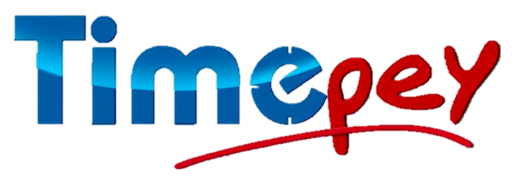
Competitive Analysis
Scalability
Cater to Banked Consumers Limiting TAM
Most Firms Cater to One Bank/ One Service Provider
Accessibility for consumers

Slide 15
Risks & Challenges
Regulation
Minimum deposit requirements, taxation on every transaction fee
Taxes & The Want for a Cash Economy
A significant number of people are happy to operate on cash for the sake of evading taxation
Adaption & Introduction of Scale
Convincing grocery stores etc. to act as agents, banks & microfinance inst. to act as master agents
Unpredictability, Corruption, Fraud
Record rates of corruption in Pakistan

Slide 16
Project Timeline
Now
Six months
Continue negotiations with financial institutions
Hire developers, team on ground in Pakistan
Launch 6 month pilot program with 200 Known Customers
Build MVP of product
Begin training master agents
Acquire pilot license
Acquire agents in dense population area for B-Testing
Iterate product from pilot data
Acquire full operation license
Three months
One year

Slide 17
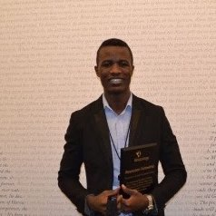

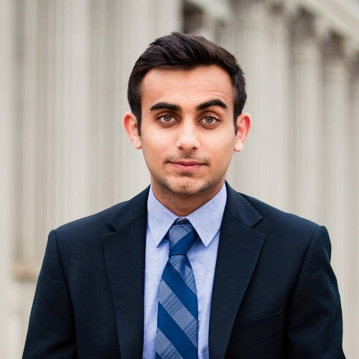


Our Team
Wyckliffe Aluga
(CEO)
Wing Vasiksiri
(COO)
Saad Hirani
(CFO)
Product Development for 7 Startups
Experience in MF in Kenya
Experience in Operations & PM
Significant Experience in Data Analysis @ TALA
On Ground Connections, Experience, Partnerships
Financial Modeling, Growth Fin-Tech Background

Slide 18
What We’re Looking For
Mentorship, Feedback
Connections with Fin-Tech Industry Leaders, Banks, Lawyers
Possible Executive Board Members
Workers / Executors ‘The Ninjas’
Need developers, on-ground team (sales & marketing)
Partnerships with Banks and MF Institutions
To create relationship for deposits, master agents
Possible Data Customers in the Future
Funding (Seed Equity)
To Develop Beta Product, Hire & Expand Team ($100k)
To Front Minimum Reserve Requirements - $2m (IRR +)

Slide 19
Appendix

Slide 20
Appendix 1: Regulatory Aspects
Operation Regulations
Application for Permission
Minimum Capital Requirements
Security and Confidentiality Laws
Unable to perform banking functions or act as custodians
Solution: Partnership with banks / MF banks
Must acquire pilot license followed by operating license
Solution: Operate a Beta with one master agent using pilot license
Required minimum capital of 200 million rupees
Solution: Partner with microfinance institutions and banks, along with fundraising
Must abide by state bank confidentiality standards
Solution: Hire a lawyer to ensure we comply with all standards

Slide 21
Appendix 2 - Market Validation & Research
Interviewed lower-middle income workers paid daily cash wages in 4 different factories to gauge if they would use product, as well as the viability of product to such customers
Low-income workers from 4 factories in Karachi earning an average income of Rs 12,000 / month i.e. $1350 per year – all unbanked
Participants worked in factories as packers, security guards, supervisors, cleaners, operators, drivers, gate-keepers, helpers etc.
All received income in form of monthly cash based payments from supervisors at factories, had cell phones for personal use
103 people said they do not send money, 27 said that they do send money (mostly via friends, by themselves in lump-sum, via cell phone credit)
~22% people saved (80% of these < Rs 500) for causes like children (education), marriage, miscellaneous and healthcare
64 of 130 people said that they would trust sending or receiving money via phones on text
All people had texting capability in Urdu or English: 40 Frequent, 18 Usual and 72 Occasional ‘Texters’

Slide 22
Appendix 3: Fraud Prevention
Put checks on the identity and legitimacy of customers, especially new new customers and those acting on behalf of others. Have a transaction limit
Record keeping and established systems of identifying and reporting unusual or suspicious transactions
Train our agents to spot activities that raise a suspicion of money laundering, and to put clear processes in place for reporting back to the us for crosschecking.

Slide 23
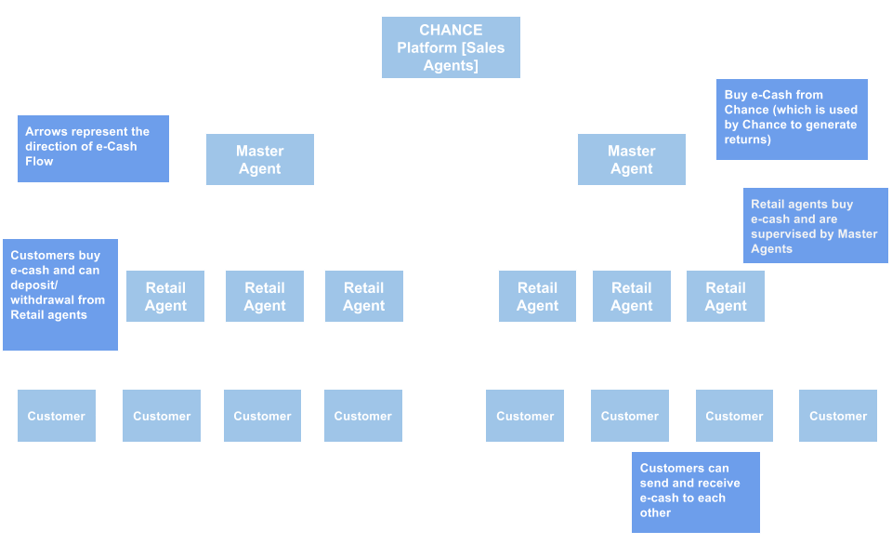
Appendix 4: Distribution Model

Slide 24
Appendix 5: Pricing Model & Example
1 Master Agent, 15 Agent, 100 Customer, 10 Transaction / Customer Model

Slide 25
Appendix 6: Financial Projections

Slide 26


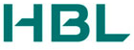

Appendix 7: Partners, Traction
Partnerships, Conversations
Market Indicators of Industry Health
Conversations with Habib Bank Limited (Largest bank in Pakistan) on relationship banking / master agent
Conversations with Akhuwat Microfinance & Aga Khan Agency for Microfinance to act as Master Agents
Interest from CEO of 21C Girls to Develop Product Technology and Join as Mentor / Board Member
45%
Of All online shopping will be on mobile by 2020
9000
ATMs unable to meet consumer demand
43%
Increase year on year increase in micro-savers
100%
Increase in mobile money transactions in 2015
65.8 million
Branchless Banking transactions occurred in 2015

Slide 27
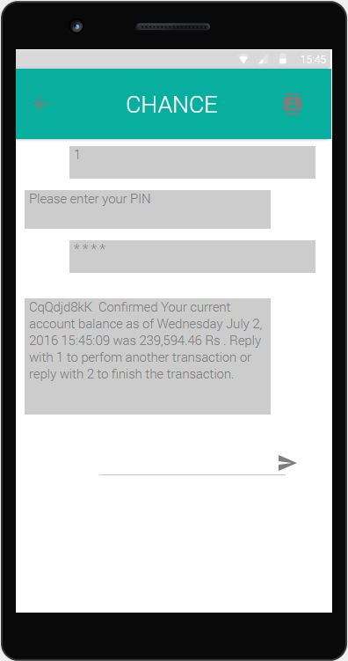
Appendix 8: Product Wireframes
SECURITY / IDENTITY VERIFICATION
Transaction Confirmation & Record

Slide 28
Appendix 9: Transactions from 0-1
Karachi
Peshawar
Mini Mart
Send Money for rent
LandLord
Open account and Deposit free
Factory
Pay School fees
School
Withdraw
Paid Cash
Send Money to his wife
John
His Wife
Grocery Store
Pay Bill
Power Bill

Slide 29
Appendix 10: The Big Picture
Understand Purchasing Power
The transactional data will also allow us to see who consumer sends money to and how often they do so
Data from the underbanked
This previous market has been untapped by banks and the transactional data of this specific population segment does not exist
Generate Potential Credit Score
Eventually we will amass enough data from each consumer, based on their spending and savings habit, to generate credit scores
Consumers Savings Habit
By seeing how often consumers make deposits and withdrawals we can understand how or even if this segment saves
Population Density
By analyzing the locations and frequency of interactions of our agents we will have a better geographical understanding of the country

