Slide 1



The emerging role of 3D printing in engineering and innovation education
Dominik Deradjat, Mélanie Despeisse, Phill Dickens, Serena Flammini, Simon Ford, Ian Hutchings, Finbarr Livesey, Tim Minshall, Letizia Mortara, Chander Velu
www.dfab.info

Slide 2
Overview
Background and context
Pathways
  Manufacturing/engineering management
  Entrepreneurship/innovation for engineers
  Supply of engineers
Possible impacts of 3D printing / AM
Conclusions

Slide 3
Overview
Background and context
Pathways
  Manufacturing/engineering management
  Entrepreneurship/innovation for engineers
  Supply of engineers
Possible impacts of 3D printing / AM
Conclusions

Slide 4
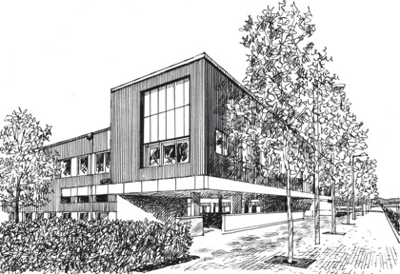

Institute for Manufacturing
University of Cambridge Department of Engineering
Dr Tim Minshall
@camtechpole / @dfab_info

Slide 5

Approach

Slide 6


















Institute for Manufacturing
RESEARCH
Management
Technology
Policy
EDUCATION
Undergraduate
Postgraduate
PhD
Open courses
Executive education
PRACTICE
Notes:
The IfM is a division of the University of Cambridge Department of Engineering and was established in 1998.
Comprising around 215 people, excluding taught course students, the IfM provides a unique environment for the creation of new ideas and approaches to modern industrial practice, from understanding markets and technologies, through product and process design to operations, distribution and related services; and set within an economics and policy context
Two things make the IfM distinctive compared with its international peers:
The IfM recognises that industrial issues are inherently multi-disciplinary and has established a team with the expertise and toolsets to address issues of industrial policy, management and technology at the levels of the firm, and of the national economy
The IfM takes an integrated approach to Research, Education and Practice; enabling academic research and teaching to be applied effectively to live industrial issues. The IfM works with companies and governments nationally, regionally (East of England) and internationally to apply its research and education outputs. This approach enables the IfM’s research and teaching to be informed by the current and emerging needs of industry, and to learn from their application in demanding industrial contexts, helping to inform research priorities
The IfM has established an integrated knowledge transfer unit called the Industry Links Unit, the external aims of which are to:
Help manufacturers globally to create and capture value more effectively
Help national, regional and international governments to establish policies and programmes that are beneficial to the development of:
Sustainable, profitable manufacturing businesses
Manufacturing and related service sector of the economy

Slide 7

http://www.andrewdunnphoto.com/

Slide 8
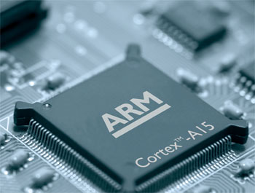
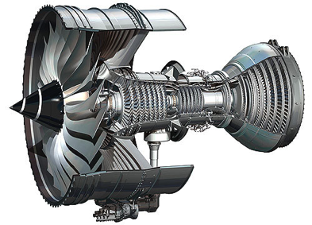

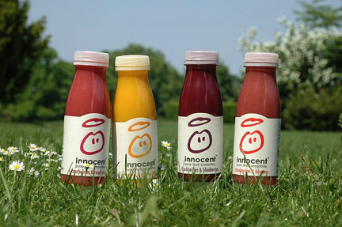

Slide 9
Some numbers
1,575 technology-based firms
.. employing 57,140 people
.. with £11.8bn total revenue
.. and combined value of £50bn
www.camclustermap.com; www.svc2uk.com

Slide 10
























Start-ups and spin-outs
Multinational corporations
Consultancies
Notes:
10

Slide 11
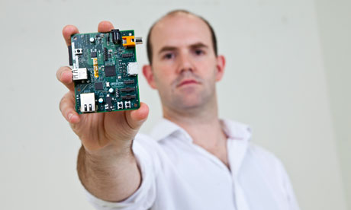

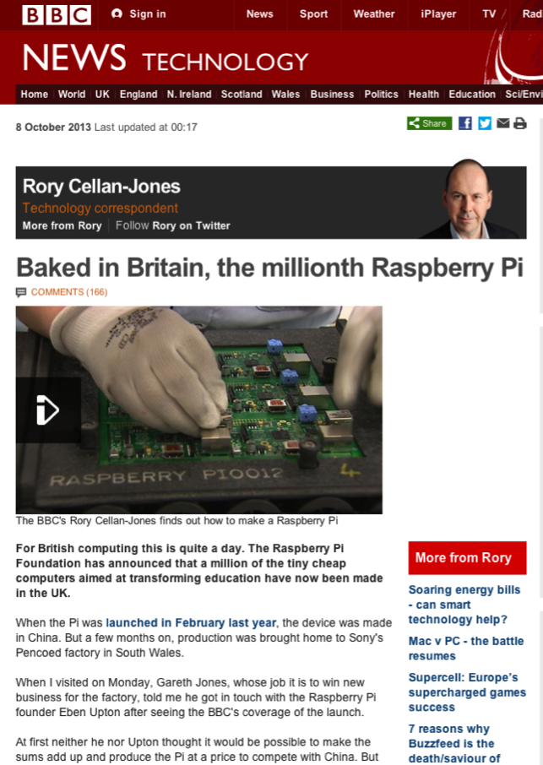

Slide 12

“A Safe Place to Do Risky Things”
Dr Andy Richards
http://www.hdwallpapersinn.com/base-jumping-wallpapers.html

Slide 13
Overview
Background and context
Pathways
  Manufacturing/engineering management
  Entrepreneurship/innovation for engineers
  Supply of engineers
Possible impacts of 3D printing / AM
Conclusions

Slide 14
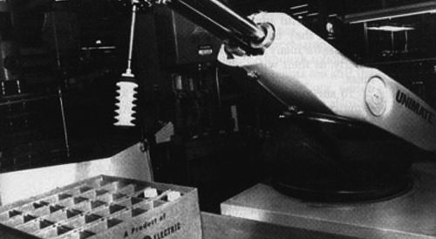
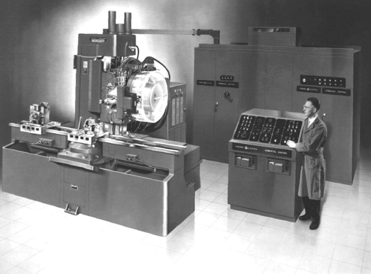
Images: http://www.cmsna.com/; www.used-robots.com

Slide 15
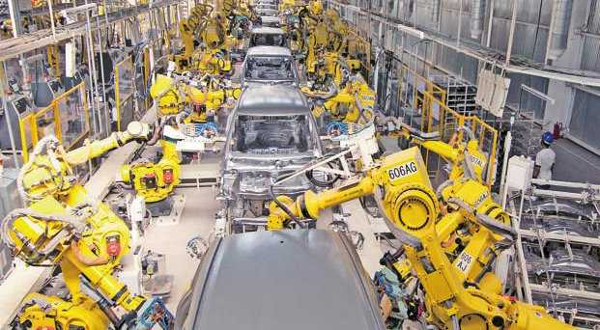
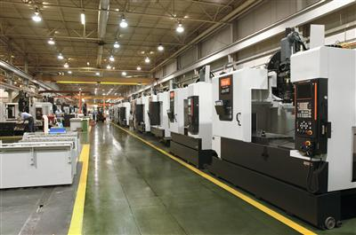
Images: Ramesh Pathania/Mint; news.cision.com

Slide 16

Changing UK context for university innovation
1960s
1995
2000
2005
2010
2015
Previous Order
Experimentation
Consolidation
Institutionalization
Multiple competitive funding schemes
Formula-driven streams of funding
Innovation and engagement core mission for universities
UK
Multiple new programmes/offices/centres
Focus onto core activities
Strategic, connected investments
Cambridge
Minshall, T., L. Mortara and T. Ulrichsen (2015). University-industry partnerships and open innovation implementation: Experiences from Cambridge 2nd World Open Innovation Conference 19-20th November 2015. Santa Clara, CA.

Slide 17
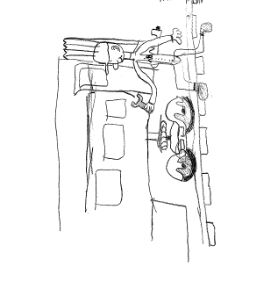
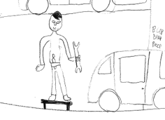
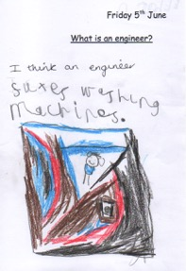
Shortage of engineers - Perceptions of engineering

Slide 18
Overview
Background and context
Pathways
  Manufacturing/engineering management
  Entrepreneurship/innovation for engineers
  Supply of engineers
Possible impacts of 3D printing / AM
Conclusions

Slide 19
3D printing ‘Bigger than internet’
FT 21.6.12
3D printing: ‘The PC all over again?’
Economist 1.12.12
‘3D printing [..] has the potential to revolutionize the way we make almost everything’
President Obama, State of the Union Address 2013

Slide 20
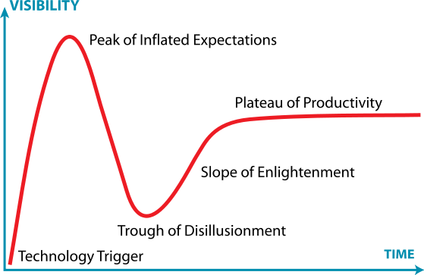
www.gartner.com

Slide 21
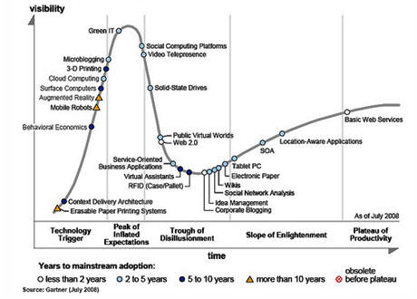
2008
www.gartner.com

Slide 22
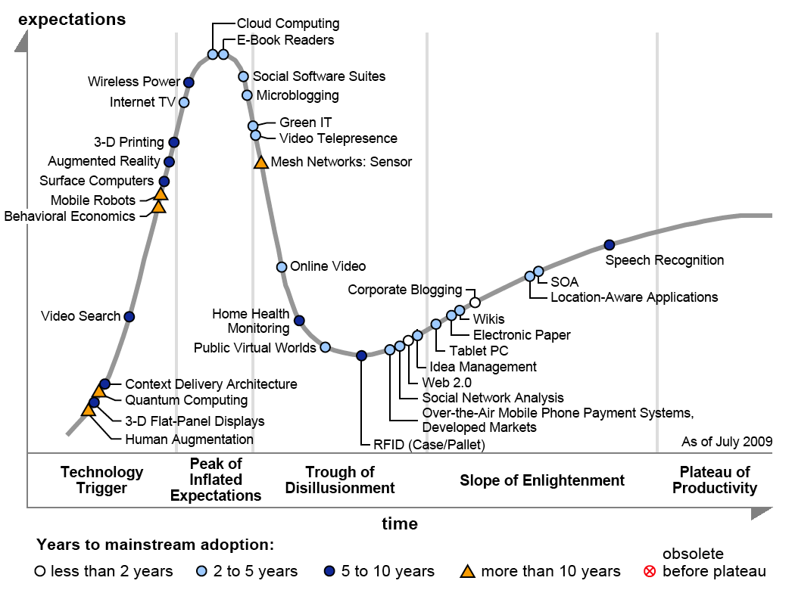
2009
www.gartner.com

Slide 23
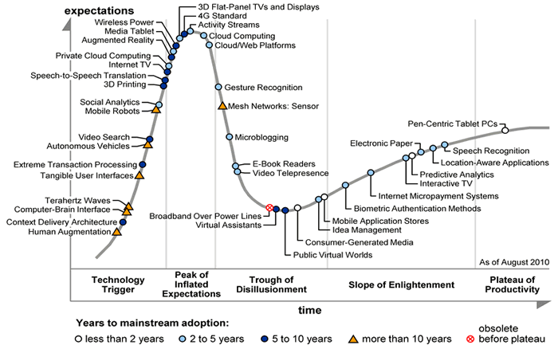
2010
www.gartner.com

Slide 24
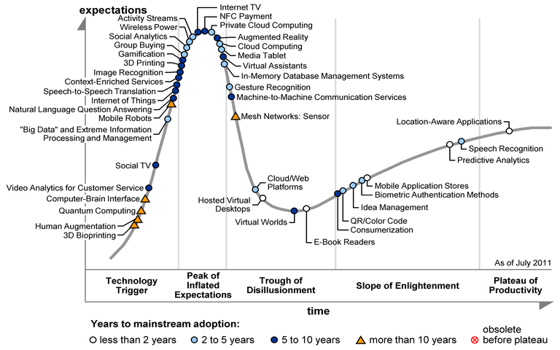
2011
www.gartner.com

Slide 25
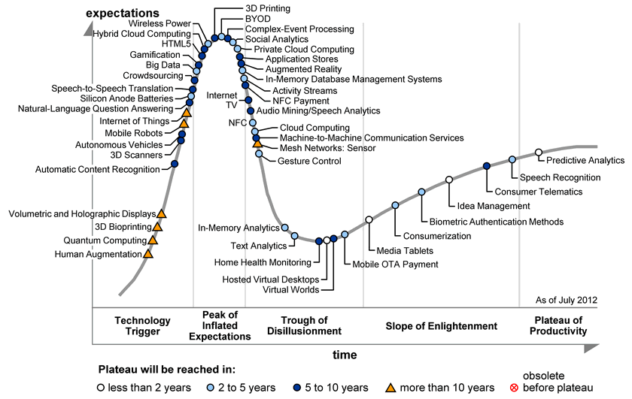
2012
www.gartner.com

Slide 26
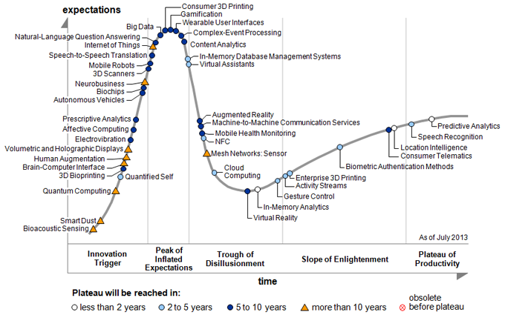
2013
[Gartner’s 2013 Hype Cycle for Emerging Technology]
www.gartner.com

Slide 27
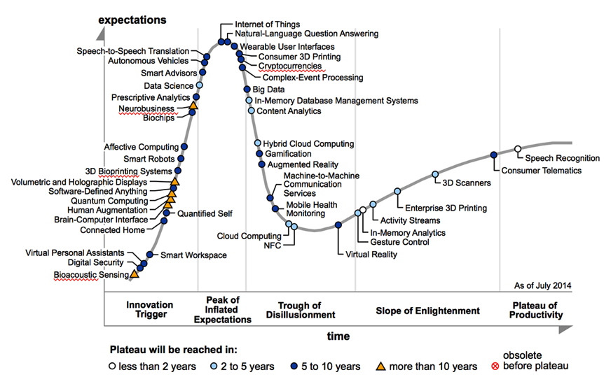
2014
www.gartner.com

Slide 28
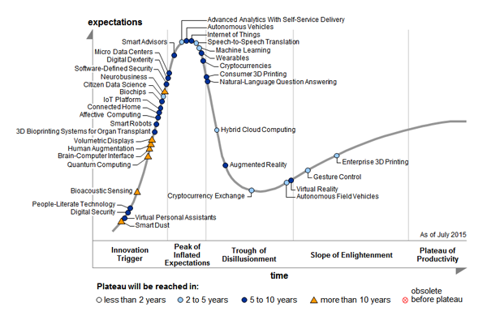
2015
http://www.gartner.com/

Slide 29
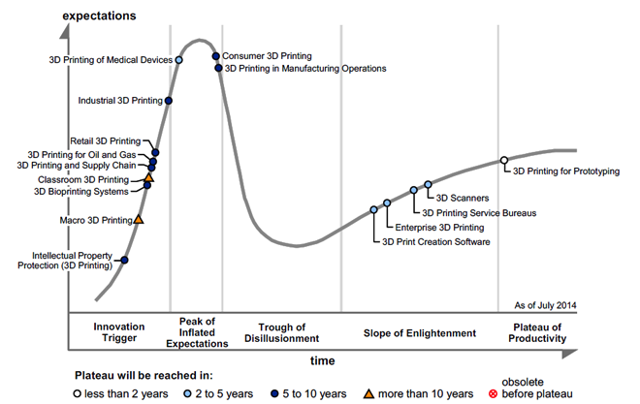
http://www.gartner.com/

Slide 30
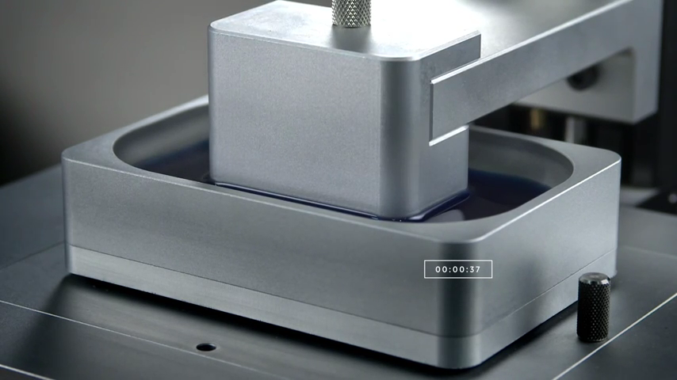
www.carbon3d.com

Slide 31
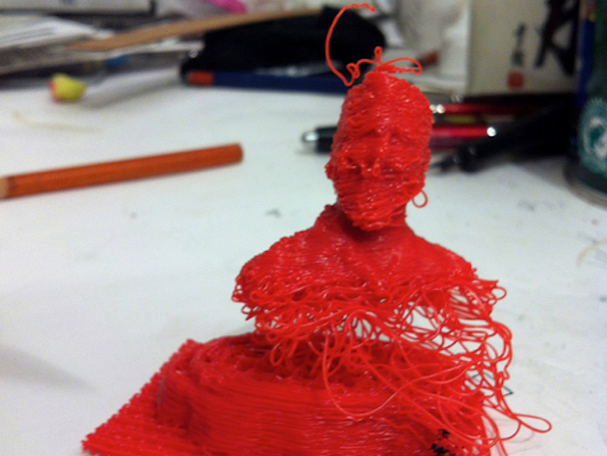
‘3D printing [..] has the potential to revolutionize the way we make almost everything’
President Obama, State of the Union Address 2013
Flickr user luccawithcheese.

Slide 32
Three 3DP-AM projects: www.dfab.info
3DP/AM and potential business model disruptions
3DP/AM-enabled re-distributed manufacturing
UK National Strategy for 3DP/AM

Slide 33
Evolution of Additive Manufacturing / 3DP applications
Rapid Prototyping
Rapid Tooling
Direct Manufacturing
With thanks to Dominik Deradjat
Notes:
AM has existed for over 25 years. It has initially found application in prototyping (known as Rapid Prototyping), progressed into being used for tooling (rapid tooling) and has progressed into being used for the direct production of end parts (rapid manufacturing)

Slide 34
Potential for mass customisation
High
Variety
Low
Low
High
Volume
With thanks to Dominik Deradjat
Notes:
A fundamental classification of business processes is in the way in which they trade-off volume and variety. By ‘volume’ we mean the number of times the process makes the same product and by ‘variety’ we mean the number of different products made by the same process. Nearly all product making businesses can be shown to lie on a volume-variety curve of the type shown above. To the far right are businesses which make few products, perhaps just one, in very high volume – a continuous oil refinery being an extreme example. Such businesses tend to have very well controlled processes, and compete by using the economies of scale to reduce prices – large car manufacturers are a good example of this. At the opposite end of the curve, at the top left, are businesses where every product is unique, or made only in very small numbers. These processes compete by offering variety – tailoring the product exactly to the customer’s needs – and thus tend to have higher costs.
The operation of processes depends greatly on where they lie on the volume variety curve.

Slide 35
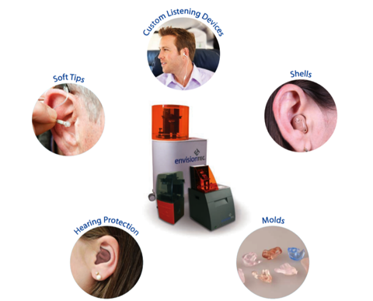
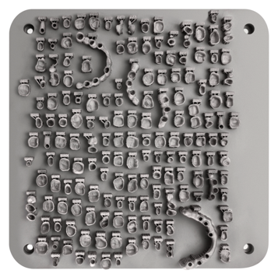
http://envisiontec.com/; www.renishaw.com
With thanks to Dominik Deradjat

Slide 36










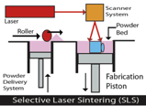
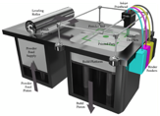
Structuring the big issues
time
Value
context
Value
capture
Value
creation

Slide 37
Looking backwards and forwards
1. Emergence
Mapping the emergence of 3DP, identifying enablers and barriers to growth
2: Disruptions
Analysing the potential disruptive effects of 3DP in specific industrial contexts
3: Scenarios
Developing future scenarios for 3DP

Slide 38
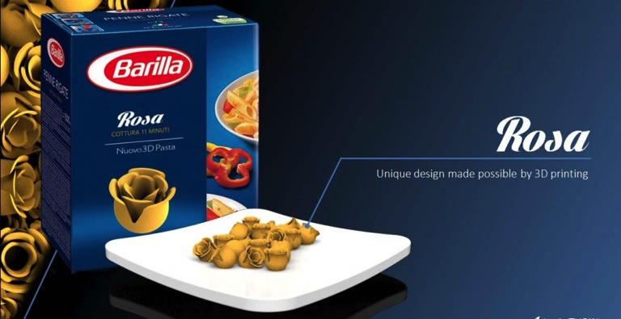
  3D Printing technologies: an opportunity for innovating with others?
Source: 3dprint.com
Rosa Pasta from Loris Tupin, a 3D model that ‘blooms’ and turns into a rose when placed in boiling water
With thanks to Dr Letizia Mortara
Notes:
A number of applications in different sectors
Several in the food and Drink industry

Slide 39

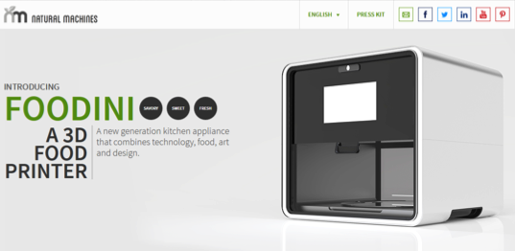

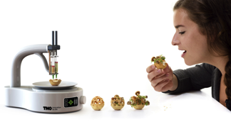
  3D Printing technologies: an opportunity for new products and platforms?
ChefJet Source: www.3dsystems.com
Source: www.naturalmachines.com
Source: www.dovetailed.co
Souce: www.tno.nl
With thanks to Dr Letizia Mortara
Notes:
A number of applications in different sectors
Several n the food and Drink industry
1) From the house and appliance sector → platform for food capsules? Foodini
2) TNO allow to 3D print meals specifically tailored to an individual eater. Using historical, physiological data, a food printer could feed you the exact amount of every given nutrient you need, while flavoring your meal based on your mood and using “alternative ingredients”
3) To the professional user to develop sophisticated Sugar structure to decorate food or to create other food forms

Slide 40
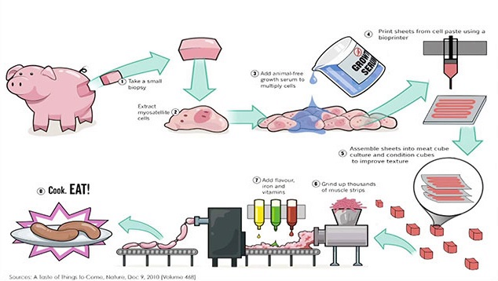
  3D Printing technologies: a potential ‘game-changer’?
Source: 3dprintingindustry.com
Source: Modern Meadow
With thanks to Dr Letizia Mortara
Notes:
to produce one quarter pounder hamburger steak:
6.7 lbs grain and forage
600 gal. water for drinking and irrigating
75 sqft land for grazing and growing feed
1,036 BTUs of energy for feed production and transportation
13.4 lbs CO2 equivalent release (same as driving your car 25 miles)

Slide 41
3DP-RDM: Defining the Research Agenda for 3D printing-enabled re-distributed manufacturing
Provides opportunities for
Medical/
pharma
Repairs/
spares
Re-Distributed
Manufacturing
3D Printing /
Additive
Manufacturing
Economics
Standards / QA
Materials
Skills
IPR
Food
Retail
Enables

Slide 42
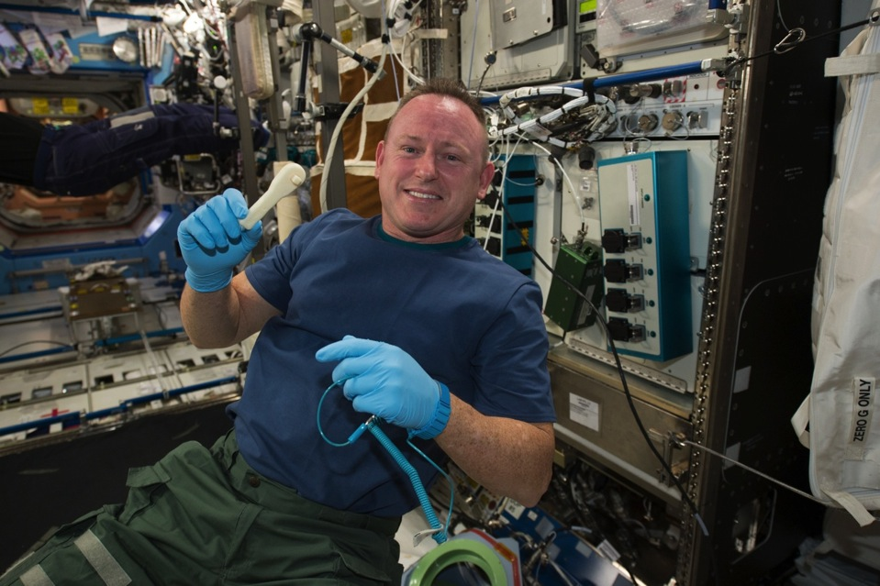
Image: NASA

Slide 43
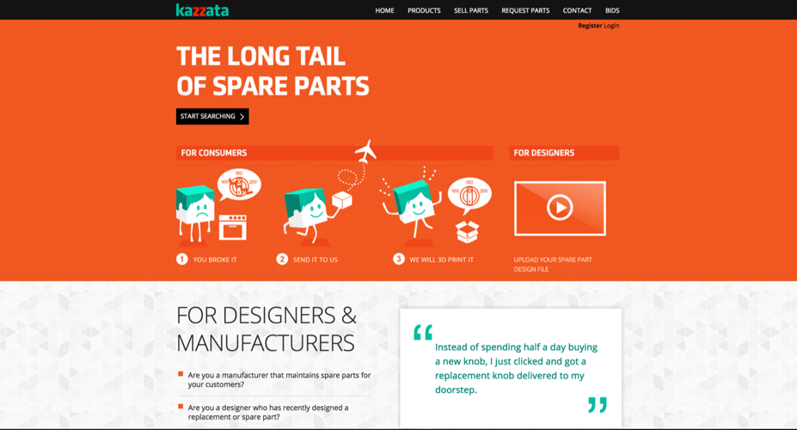
http://kazzata.com/

Slide 44
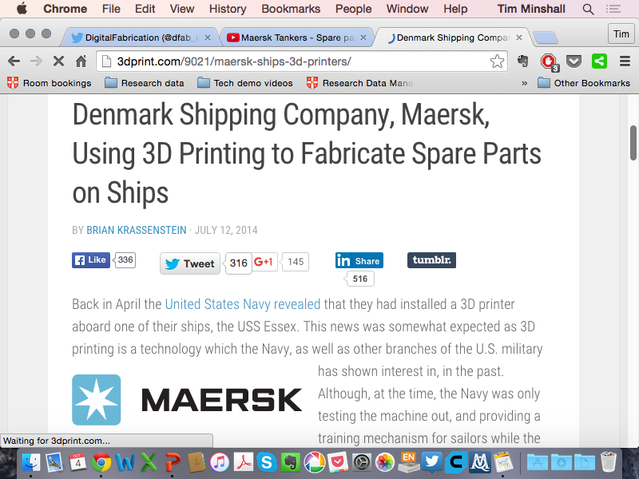

Slide 45
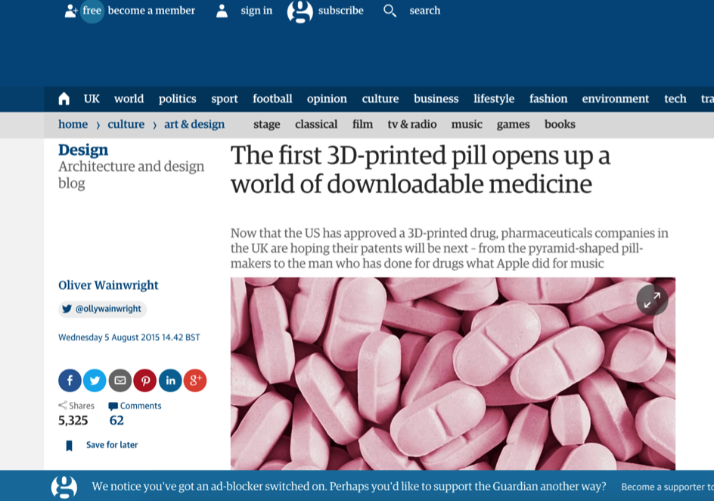
http://www.theguardian.com/artanddesign/architecture-design-blog/2015/aug/05/the-first-3d-printed-pill-opens-up-a-world-of-downloadable-medicine

Slide 46
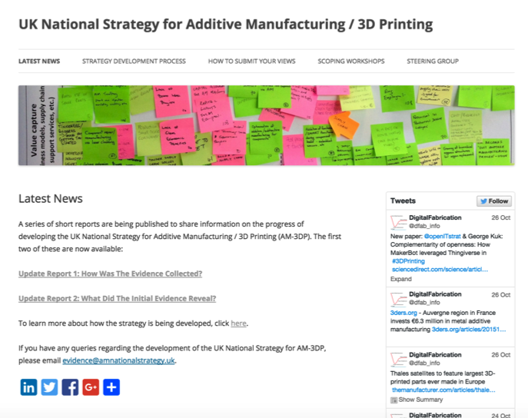
www.amnationalstrategy.uk

Slide 47
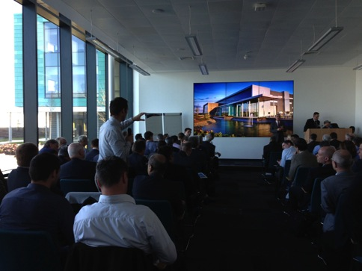
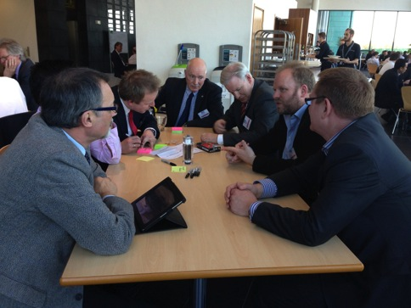
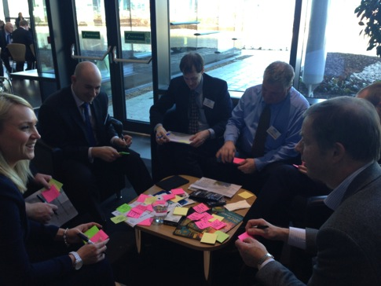
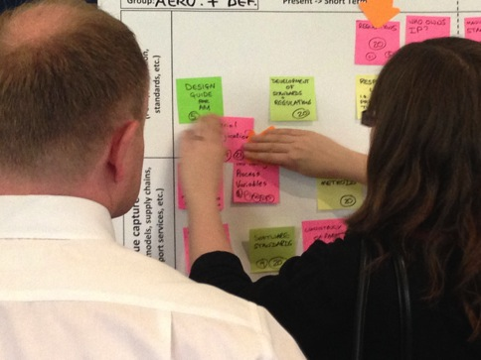

Slide 48
Issue | Summary of common perceived barriers
Materials | Understanding properties in different processes / machines / applications, QA, costs, availability (IP constraints, independent suppliers), use of mixed materials, recyclability, biocompatibility.
Design | Need for guides and education programmes on design for AM – better understanding of design for AM constraints, availability of AM-skilled designers, security of design data.
Skills / Education | Lack of appropriate skills (design, production, materials, testing) preventing adoption, up-skilling current workforce vs. training of next generation, education of consumers, awareness in schools.
Cost / Investment / Financing | Funding to increase awareness and reduce risk of adoption (testing, scale-up, machine purchase) – especially for SMEs, understanding of full costs (including post-processing, testing), cost of materials.
Standards / Regulation | Perceived or actual lack of standards – all sectors / sector specific (especially aero / health / motorsport), for processes / materials / software / products / applications.
Measurement / Inspection / Testing | Need data libraries, standards for tests (general and sector specific), materials/ in-process / final part, tests for higher volumes, non-destructive testing, QA through lock-in c.f. open access to data.
IP / Protection / Secrecy | Balancing need for openness to share knowledge with need for commercial protection to capture value from investments, enforcement of IP rights.

Slide 49

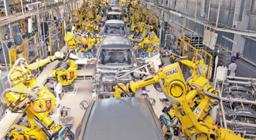
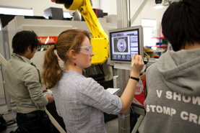
Is this ‘just another production process’?

Slide 50
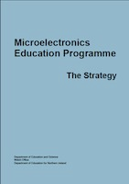
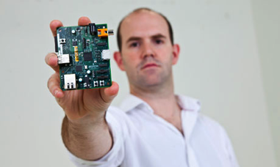
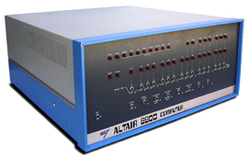

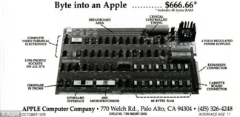
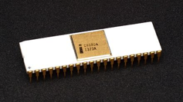
Is this a like computing in the 70/80s?
“[..] the personal computer will fall flat on its face in business”
Ken Olsen, Digital Equipment Corporation
Images: http://www.computerhistory.org/; oldcomputers.net; Konstantin Lanzet; Evan-Amos; Apple Inc.

Slide 51
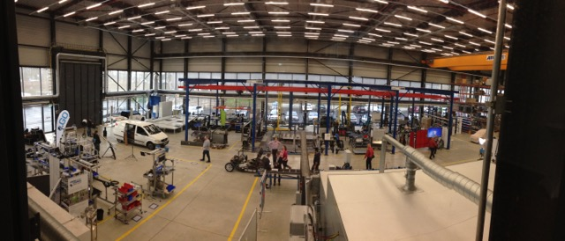

Is this part of something much bigger?

Slide 52
3D Printing & engineering/innovation education – areas for investigation
Interplay between hardware, software, design (freedom) and materials (properties)
Enhancing prototyping / feedback for innovation
Raising the visibility of engineering as subject of study?
Changing the learning processes?
  +ve and -ve

Slide 53



The two sides of ‘rapid’
Experiment, iterate, improve, learn, ..
But …

Slide 54
Summary
Background and context
Pathways
  Manufacturing/engineering management
  Entrepreneurship/innovation for engineers
  Supply of engineers
Possible impacts of 3D printing / AM
Conclusions
Experimentation
Consolidation
Institutionalization
??

Slide 55







Contact
Institute for Manufacturing
Department of Engineering
17 Charles Babbage Road
Cambridge, CB3 0FS
United Kingdom
Call us: +44 (0) 1223 766141
Email us: ifm-enquiries@eng.cam.ac.uk
@ifmcambridge
facebook.com/ifmcambridge
linkedin.com/company/institute-for-manufacturing
youtube.com/ifmcambridge
plus.google.com/+ifmcambridge/
@ifmcambridge

