Slide 1
Kasvu (=growth) open
Once a GVL Network Initiative of a Growth Plan Competition –
Today a National Phenomenon Having an Impact on Economy in Finland
Global Venture Lab Summit, Jan 8th 2016
Dr Mari Suoranta

Slide 3
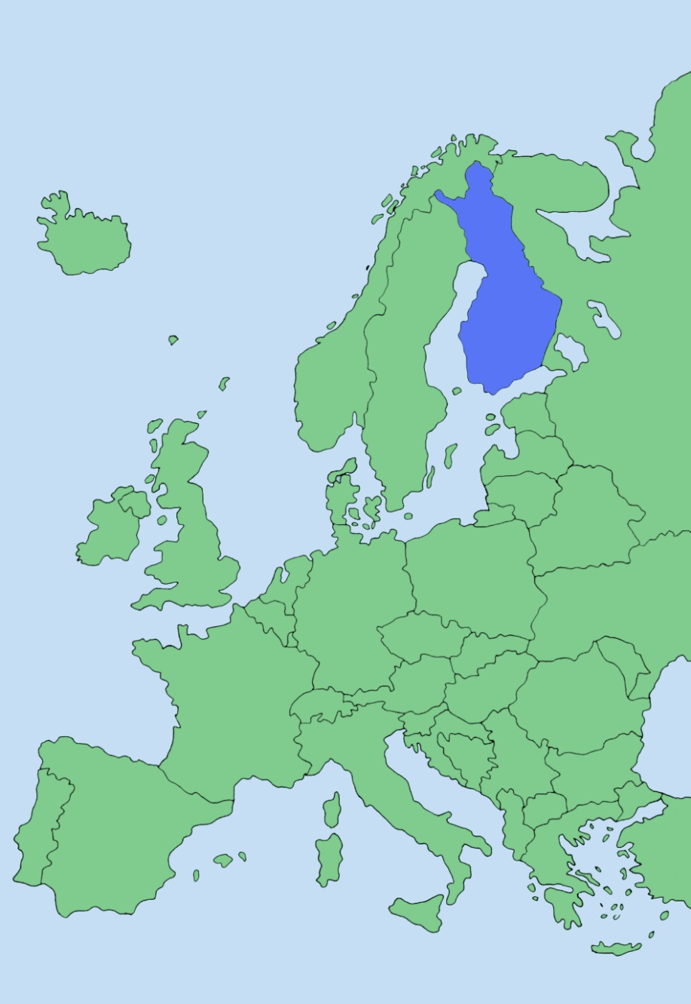
University of Jyväskylä
Founded in 1934
One of the largest
universities in Finland
Total income 204
million euro
7 faculties
Some 15,000 students
Faculty & staff about 2,600
FINLAND
Jyväskylä
London
Berlin
Paris
Rome
Madrid
Athens

Slide 4
Mari Suoranta
Assistant Professor; since 2003 at JSBE
2008, 2010-2011, 2013-2014 Visiting Scholar/Fulbright Senior Fellow, UC Berkeley (US)
2015 Visiting Scholar, Birmingham Business School (UK)
Research interests: Entrepreneurial Marketing, SMEs, Firm Growth, High Tech Firms, Entrepreneurship Education
Teaching: Innovative Marketing, Venture Lab, Selling, Research Methodology etc.

Slide 5
Agenda
Kasvu Open – What
Kasvu Open – Why
Kasvu Open – How
Kasvu Open – Impact & Future

Slide 7
What?
Kasvu Open is not just a typical business plan competition but it is the largest project for sparring eager to grow companies with growth experts in Finland
Throughout the competition every growth company has an opportunity to present their growth plan to a great number of experts free of charge
As a result, companies have a clarified growth plan, enlarged network of the best possible growth venture experts and investors in the country
Not just for startups or early stage businesses but 2 series: Startup and Start Again

Slide 8
Why new initiatives were needed? Brief History of Kasvu Open
Since 2008 economic downturn, 2015 GDP annual growth rate 0.2% in Finland
Global Entrepreneurship Monitor results e.g. only 11% of Finnish early-stage entrepreneurs have strong international orientation
2009-2010 Research project “Runway-to-Growth” funded by the TEKES Finnish Funding Agency for Innovation
Experiments and testing Runway-to-Growth tool
We did some trial Runway-to-Growth workshop/sparring events also in Berkeley 2011 and San Jose 2012
After the end of the project ideas and concepts were handed over to the Central Finland Chamber of Commerce

Slide 9
University of Jyväskylä, Finland – UC Berkeley, USA – IIT Kharagpur, India Marko Seppä Ikhlaq Sidhu Dhrubes Biswas

Slide 10
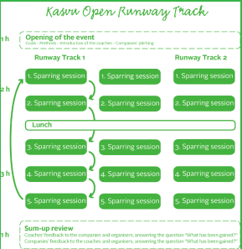
Runway-to-Growth Day Sparring sessions
Course xxxx

Slide 11
Runway-to-Growth Day Sparring sessions e.g. Berkeley 2011
1. FINANCE (growth funding prospects, including VC): David Epstein, Epstein Advisors
2. GOVERNANCE (key admin & fiscal issues related to growth): Claire Hayes, PwC
3. LEGAL (contractual and IPR related questions): Mark Ostrau, Fenwick & West
4. MARKETING (branding and sales topics): Sami Keinanen, Luxus San Francisco
5. PARTNERSHIPS (supply and distribution alliances):
Michael Kelly, Woods & Kelly

Slide 13
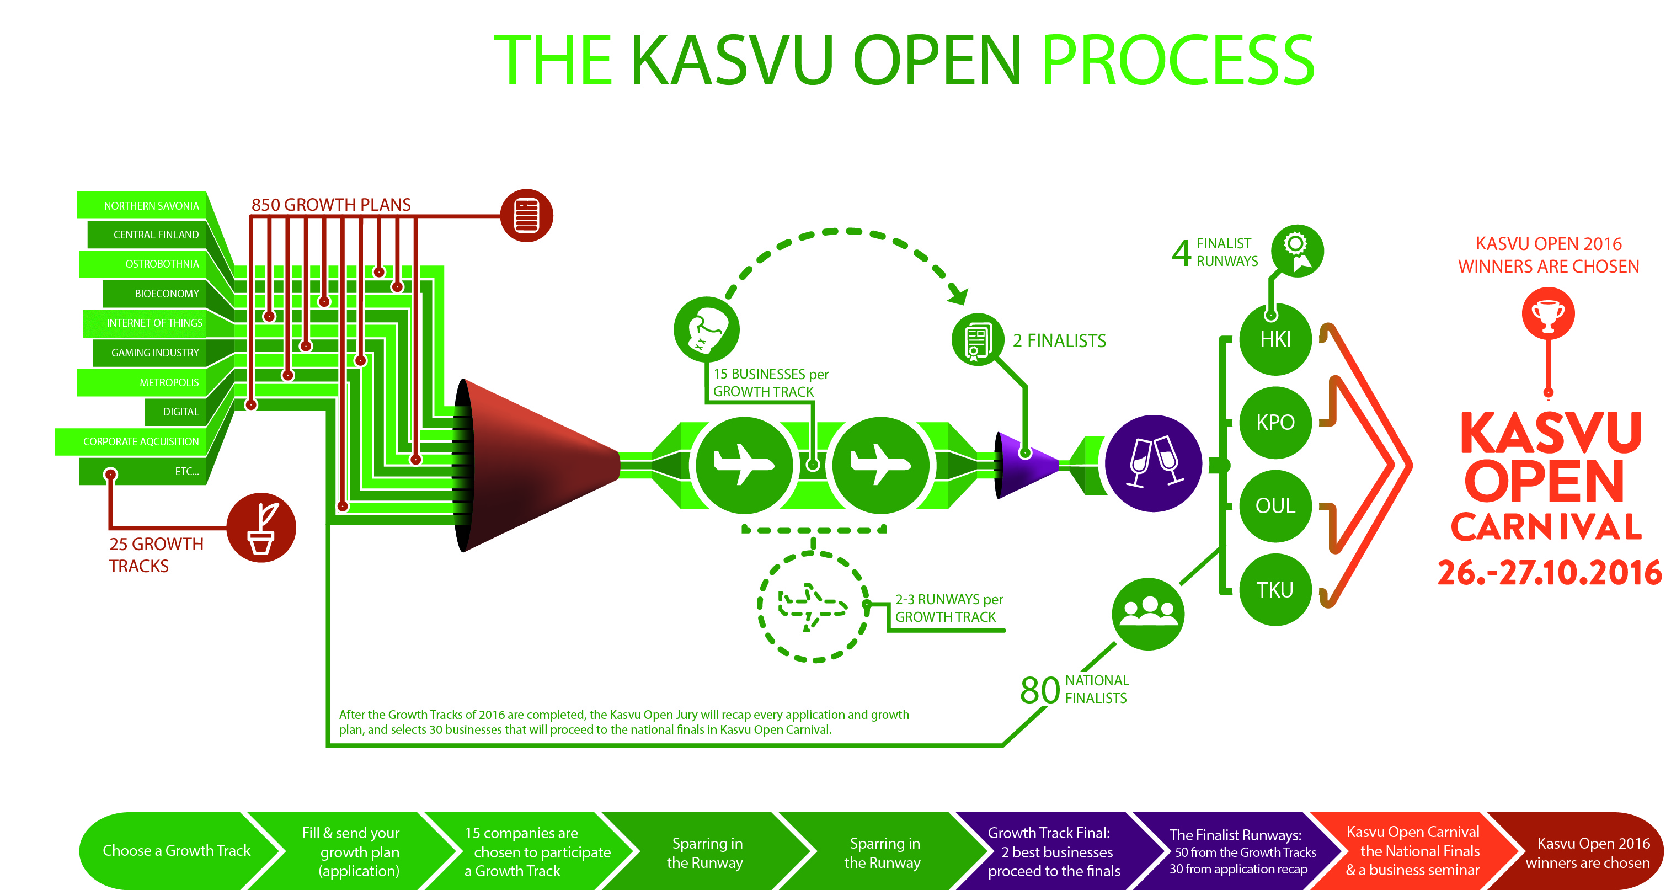

Slide 14
Kasvu Open 2015 Some numbers
In 2015 over 900 experienced managers met 455 small and medium size companies for a total amount of time exceeding 4550 hours in 114 event days

Slide 15
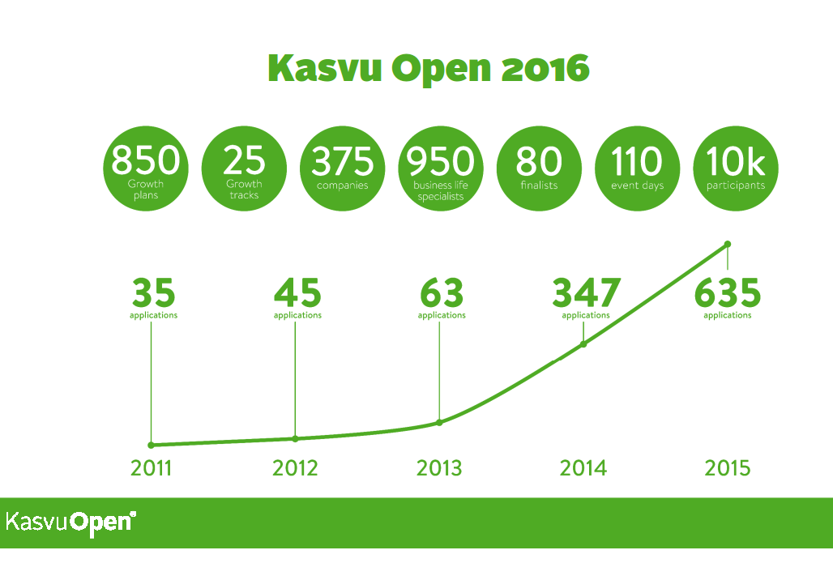

Slide 16
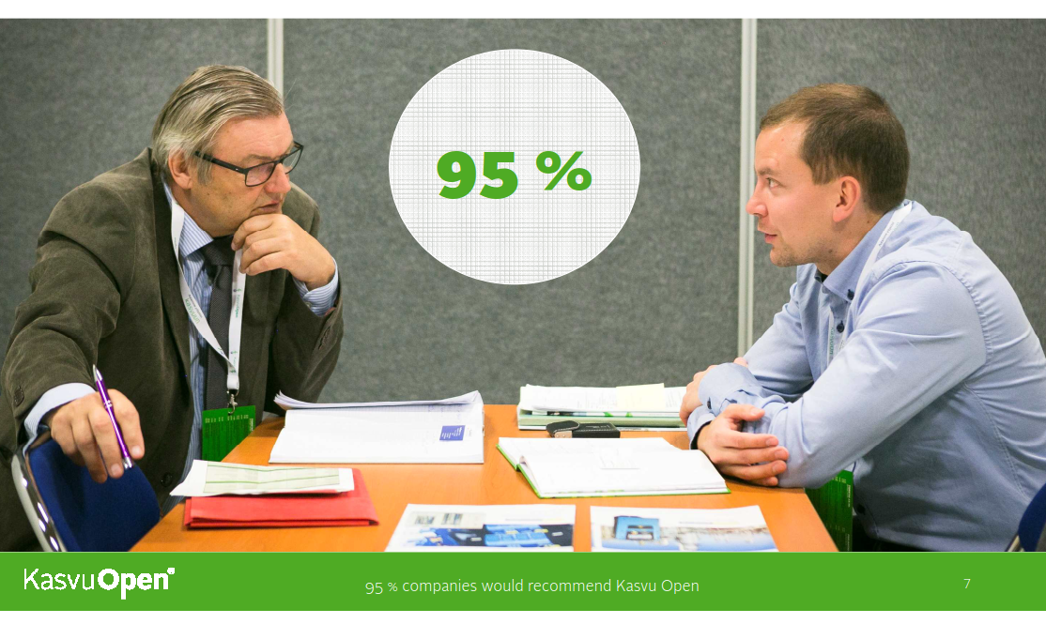

Slide 17
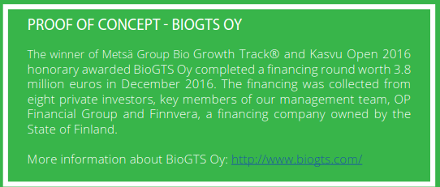
Testimonials – Proof of Concept

Slide 18
Impact
A university research project idea and concept
→ National phenomenon
Unique
Free of charge
Business experts/mentors commit their time and knowhow for the greater good (2015 estimate 4550 hours in 114 event days)
Enabled by the sponsors and partnerships

Slide 20
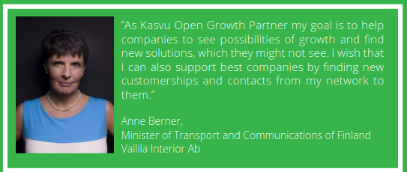
Impact
Emergence of the “pay it forward” culture in Finland

Slide 21
Impact & Future
Kasvu Open is a growth business in itself
Growth and inception of companies for example Kasvun Roihu Ltd to take care organization and facilitation of Kasvu Open processes → spillover effects
Entrepreneurship education, Kasvu Open growth track for students
Internationalization of Kasvu Open concept
→ international concept in 2016, will be organized in London, Stockholm, Oslo, Copenhagen and Saint Petersburg

Slide 22
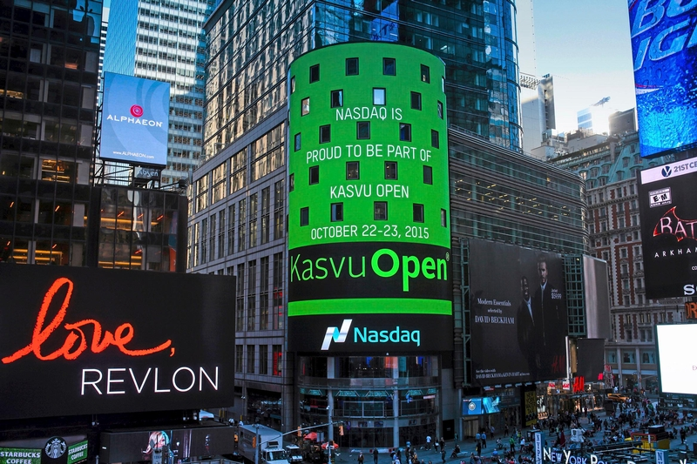

Slide 23
More Info & Co-Operation
Nina Rautiainen
Partner, CBO
Kasvun Roihu Ltd
nina@kasvunroihu.fi
Tel. +358 44 044 111
https://www.kasvuopen.fi/en
https://www.youtube.com/watch?v=Ige9YHaJ9GM

Slide 24
Research on Kasvu Open
Helin, E. & Kangasvieri, T (2015) “Bolstering firm growth: Kasvu Open 2014”. MSc. thesis.
Puistovirta, N. (2014) “Yritysten saamat resurssit Kasvu Open 2012 –sparrausprosessista”. MSc. thesis.
Comparative, global studies?

Slide 25
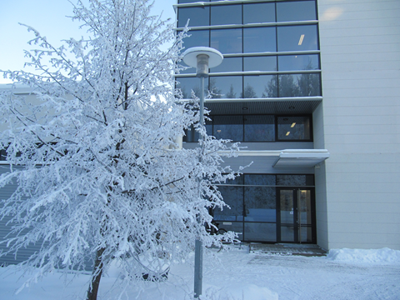
Thank You! mari.suoranta@jyu.fi

